Slide 1
Breakout 3: Switching to rail How to encourage the shift?
Moderator:
Dr. Andrea Giuricin Chief Executive Officer, TRA Consulting
Panelists:
Emmanuel Mounier Secretary General, EU Travel Tech
Raul Cazan President, 2Celsius
Jacqueline Starr Chief Executive Officer, Rail Delivery Group

Slide 2
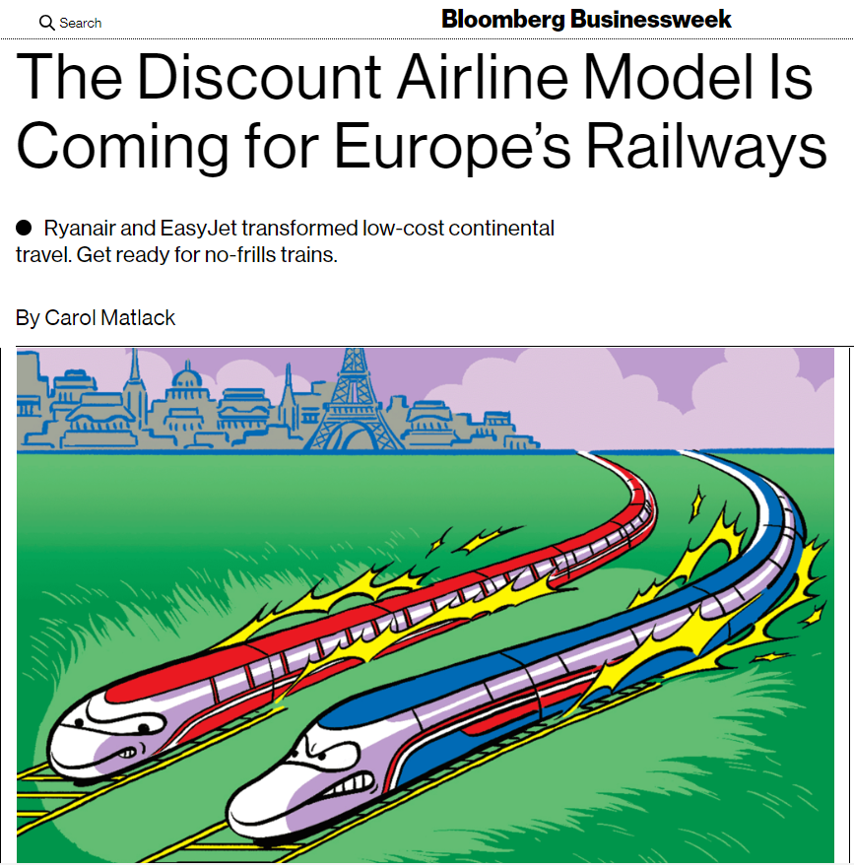
Competition is coming..

Slide 3
Modal Shift to Rail?

Slide 4
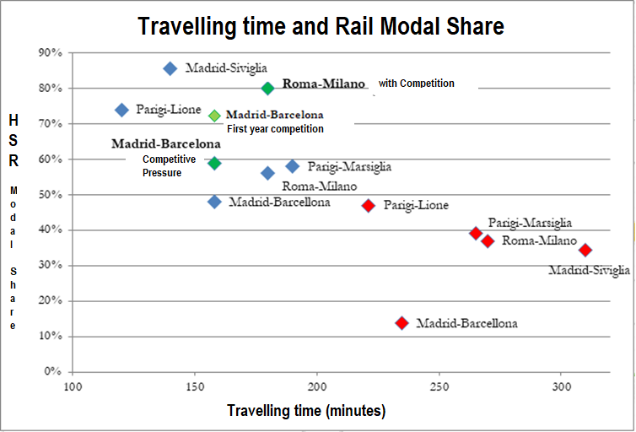
HSR and Aviation: Modal Share
Source: TRA consulting

Slide 5
Sustainability and Multimodality
Air Transport
Connectivity
Digitalization (ex. Web sales > 90%)
HS
Rail
SAF (cost problema)
New fleet
Airports carbon zero
Public Transport
Long distance buses
Source: TRA consulting

Slide 6
Breakout 3: Switching to rail How to encourage the shift?
Moderator:
Dr. Andrea Giuricin Chief Executive Officer, TRA Consulting
Panelists:
Emmanuel Mounier Secretary General, EU Travel Tech
Raul Cazan President, 2Celsius
Jacqueline Starr Chief Executive Officer, Rail Delivery Group

