Slide 1
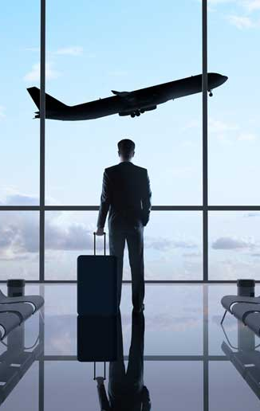
Greg Toussaint, Director, Edgar, Dunn & Company and GBTA European Payments Committee Member
…
How to be prepared for the future of corporate travel payments

Slide 2
Introduction
Greg Toussaint
Director, Edgar, Dunn & Company GBTA European Payments Committee Member
….
2

Slide 3
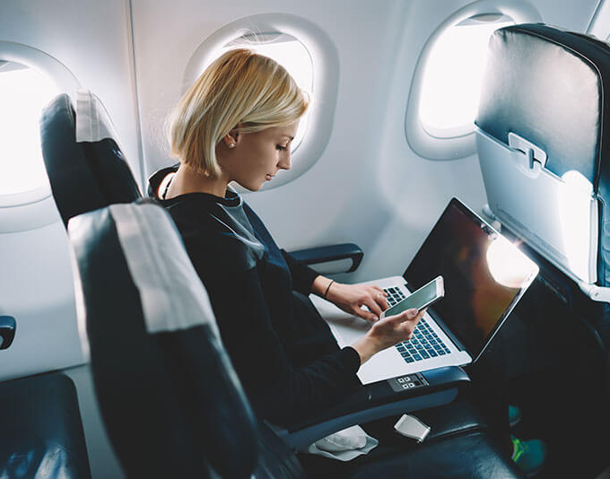
Agenda
Current situation: how to formulate an efficient corporate travel payments strategy?
Back to the future: what will be the future of corporate travel payments?
Let’s use Sli.do! [Sli.do code, e.g. GBTAPayments]
3

Slide 4


1. Current situation: how to formulate an efficient corporate travel payments strategy?
4

Slide 5
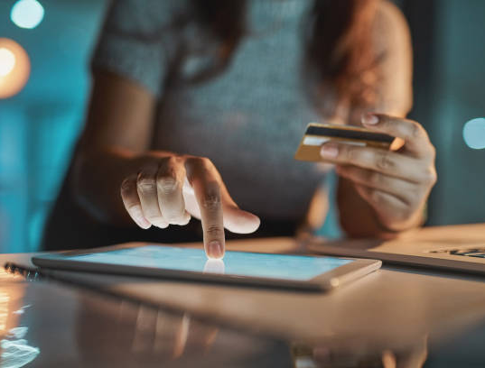
How to formulate an efficient corporate travel payments strategy?
Different payment methods to capture travel expenses
Lodge account
Plastic corporate cards
Plastic individual consumer cards
Virtual cards
  Centralised virtual cards
  Corporate cards digitalised in mobile wallets
  Fully digital virtual cards
5

Slide 6
Sli.do question (not to be shown on screen)
Which payment methods do you currently use for corporate travel payments?
Cash
Lodge account
Plastic corporate cards
Plastic individual consumer cards
Virtual cards used centrally to book travel
Virtual cards used by traveller (corporate cards digitalised in mobile wallets)
Fully digital virtual cards (e.g. new hire, project specific, interviews)
6

Slide 7
Why and when do we use payment methods for corporate travel?
Lodge account (pre-trip: air, train)
Plastic corporate cards (in-trip expenses: hotel, restaurants, taxis)
Plastic individual consumer cards
Virtual cards
  Used centrally (pre-trip: MICE)
  Used by traveller: corporate cards digitalised in mobile wallets (in-trip expenses)
  Fully digital virtual cards (in-trip expenses)
7
Notes:
Pros and cons

Slide 8

2. Back to the future: what will be the future of corporate travel payments?
8

Slide 9

Will there be any future of payments?
Regulations: impact of Strong Customer Authentication (SCA) in Europe
Requirement to have secured transactions
Two-factor authentication
Issues related to the complex value chain in travel
9

Slide 10
Sli.do questions (not to be shown on screen)
Are you aware of the regulation related to Strong Customer Authentication (SCA)?
Do you understand the impact of Strong Customer Authentication on the customer journey?
Are you aware of the impact of non-compliance related to Strong Customer Authentication?
Do you intend to be compliant this Strong Customer Authentication regulation?
10

Slide 11
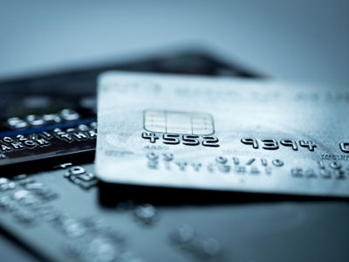
Shall we need cards any more?
New technologies are emerging
Open banking and payment initiation
Real-time payments
Cryptos and blockchains
What is the impact on corporate travel?
11

Slide 12
Sli.do questions (not to be shown on screen)
Are you aware of the following technologies:
Open banking and payment initiation
Real-time payments (ACH, bank transfer)
Cryptos and blockchains
12

Slide 13
Sli.do questions (not to be shown on screen)
Which technologies are the most likely to impact corporate travel?
Open banking and payment initiation
Real-time payments
Cryptos and blockchains
13

Slide 14

Minority report: towards fully digital processes
Towards end-to-end fully digital customer journeys
Booking
Payment
Expense management
Reconciliation
Reporting
14
Notes:
Security

Slide 15
Sli.do questions (not to be shown on screen)
Which parts of the travel value chain still require manual processes?
  Booking
  Payment
  Expense management
  Reconciliation
  Reporting
15

Slide 16
Sli.do questions (not to be shown on screen)
Which parts of the travel value chain would you like to automate?
  Booking
  Payment
  Expense management
  Reconciliation
  Reporting
16

Slide 17

One integrated payment solution to rule them all
One solution integrating all different payment methods
Includes lodge account, plastic corporate cards, different types of virtual cards
Significant potential benefits: automation and digitalisation, increased internal efficiency
17

Slide 18
Sli.do questions (not to be shown on screen)
Does your company have a corporate travel payment strategy?
Are you interested in the concept of an integrated payment solution (including all payment methods)?
18

Slide 19
Sli.do questions (not to be shown on screen)
Which are the benefits of an integrated payment solution?
  Easier use of different payment methods
  Automation of payments
  Increased internal efficiency
19

Slide 20

Conclusions
20

Slide 21
Stay informed about payments to make the correct decisions
Corporate travel payments are evolving: stay aware of trends
Understand impacts and benefits for your company
Evolve at your own rhythm to offer the best digital payment experience
21

Slide 22
Before you leave
Give us Your Feedback -
It’s in the App!
1- Click on « Schedule »
2- Find and add your session
3- Move to the bottom
4- Take the survey ☺
Join us to continue this conversation!
« Meet the experts »
Re:Imagine area in the Expo
11:15 – 11:45
Table 11

Slide 23
thank you for attending :)

