Slide 1


EDUCATION SESSION: PANEL DISCUSSION
The Importance of Factoring Traveler Experience & Satisfaction on
Post-Pandemic Hotel Procurement

Slide 2

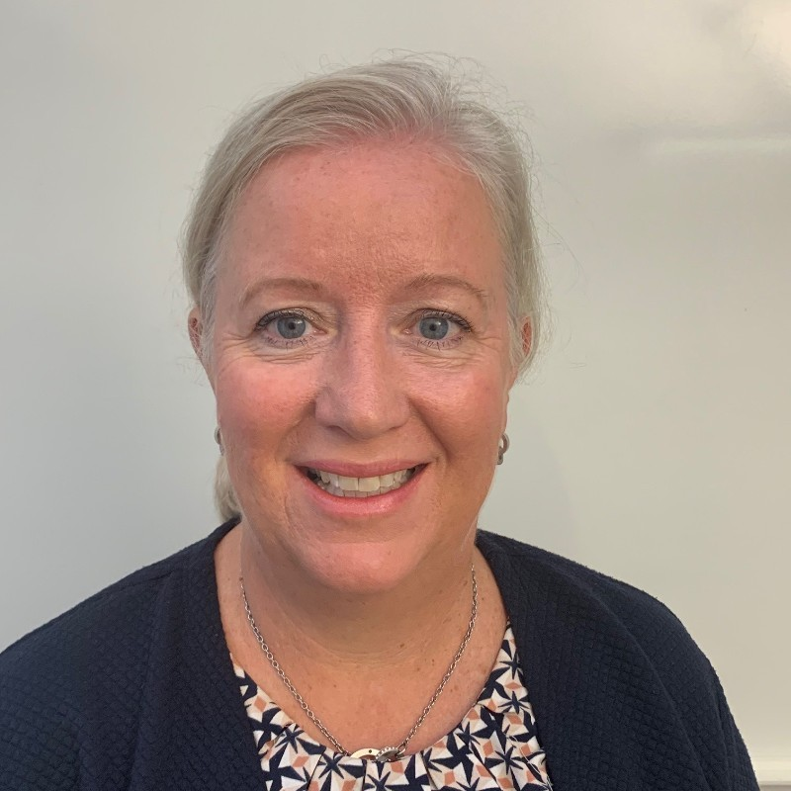
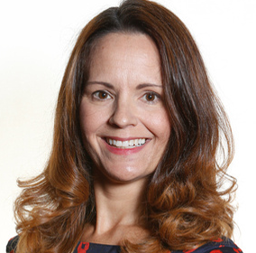
Our Speakers
Andreas Schönfeld
SVP Global Strategic Accounts & CGO HRS Work, HRS Group
Ulrika Rosen
Travel & Meeting Manager,
Tetra Pak
Natalie Moran
VP of Business Development,
NH Hotels

Slide 3

The world has changed…

Slide 4

Time for a poll: Join now!
Please join at slido.com with #2330066

Slide 5
Question to the Audience #1
Which of these trends will be your top 3 priorities post-covid?
Remote Work
Demand for sustainable travel
Higher hygiene & quality standards
Touchless Check-In & -Out
Higher service level of suppliers
More booking flexibility
Touchless payment options

Slide 6


Which of these trends will be your top 3 priorities post-covid?
ⓘ Start presenting to display the poll results on this slide.

Slide 7

Workforce has been affected…

Slide 8
Time for a poll: Join now!
Please join at slido.com with #2330066

Slide 9
Question to the Audience #2
What are the worst pain points on travel for you?
Expense reporting
Use of personal credit card
  Waiting in line for Check-In & -Out
  Low/No availability at preferred Hotels
  Lengthy search & book process
  Usage of multiple tools
  Uncertainty/Intransparency on travel policy/compliance
  Quality gap of Hotel: booked vs. reality

Slide 10
What are the worst paint points on travel for you?
ⓘ Start presenting to display the poll results on this slide.

Slide 11

Personalized End2End experience

Slide 12

Find out more about HRS
Learn more about recent trends and developments in business travel and how HRS is reinventing how businesses stay, work and pay.

Slide 13
Before you leave
Give us Your Feedback -
It’s in the App!
1- Click on « Schedule »
2- Find and add your session
3- Move to the bottom
4- Take the survey ☺
Join us to continue this conversation!
« Meet the experts »
Re:Imagine area in the Expo
11:15 - 11:45
Table 7

Slide 14
thank you for attending :)

