Slide 1


Nicholas Hymans,
Global Director of Operations and Travel Security, Deutsche Bank
Jorge Mesa,
Director Global Crisis Management,
BCD Travel
Be More Strategic:
Morphing Your TRM Program to Support All Your People

Slide 2
Topics to be discussed
Use ISO 31030 to your benefit to protect all your people
It’s not TRM Anymore – It’s People Risk Management (PRM)
You bring a lot to the table – skills and tools
How to get traction within your organization

Slide 3
Travel Risk Management
Travel Risk Management (TRM): coordinated activities to direct and control an organization with regard to travel risk
From ISO 31030:2021 TRAVEL RISK MANAGEMENT — GUIDANCE FOR ORGANIZATIONS

Slide 4
Duty of Care is Only Half the Story
Travel
Wellness
Posted/Assignment
Work from Anywhere
Safety
Fraud
Insider Risk
Reputation
Corruption
Theft
Duty
of
Care
Risk
to
Company
People

Slide 5
Use ISO 31030 to your benefit
to protect all your people

Slide 6

What is the Objective of ISO 31030?
FOR YOU: “This document is intended to assist those managing and participating in organizational travel.”
YOUR PROGRAM: “Travel risk management (TRM) requires that organizations anticipate and assess the potential for events, develop treatments and communicate anticipated risk exposures to their travelers.”
THE BENEFIT: “This document provides a means for organizations to demonstrate that travel decisions are based on the organization’s capacity to treat risk using internal resources or with external assistance.”
From ISO 31030:2021 TRAVEL RISK MANAGEMENT — GUIDANCE FOR ORGANIZATIONS

Slide 7
It’s not TRM Anymore
It’s People Risk Management (PRM)

Slide 8
What's New With Duty of Care?
It’s not TRM Anymore – It’s People Risk Management
EVOLVING
DUTY OF CARE
CONSIDERATIONS
Organizations must anticipate evolving workforce security risks and institutionalize ongoing monitoring, assessment, mitigation, communication and response processes to address:
ANXIETY increased
MENTAL WELLNESS support programs
VIOLENCE and active threat
CYBER vulnerability
LIABILITY reduction
DIVERSITY and inclusion programs

Slide 9
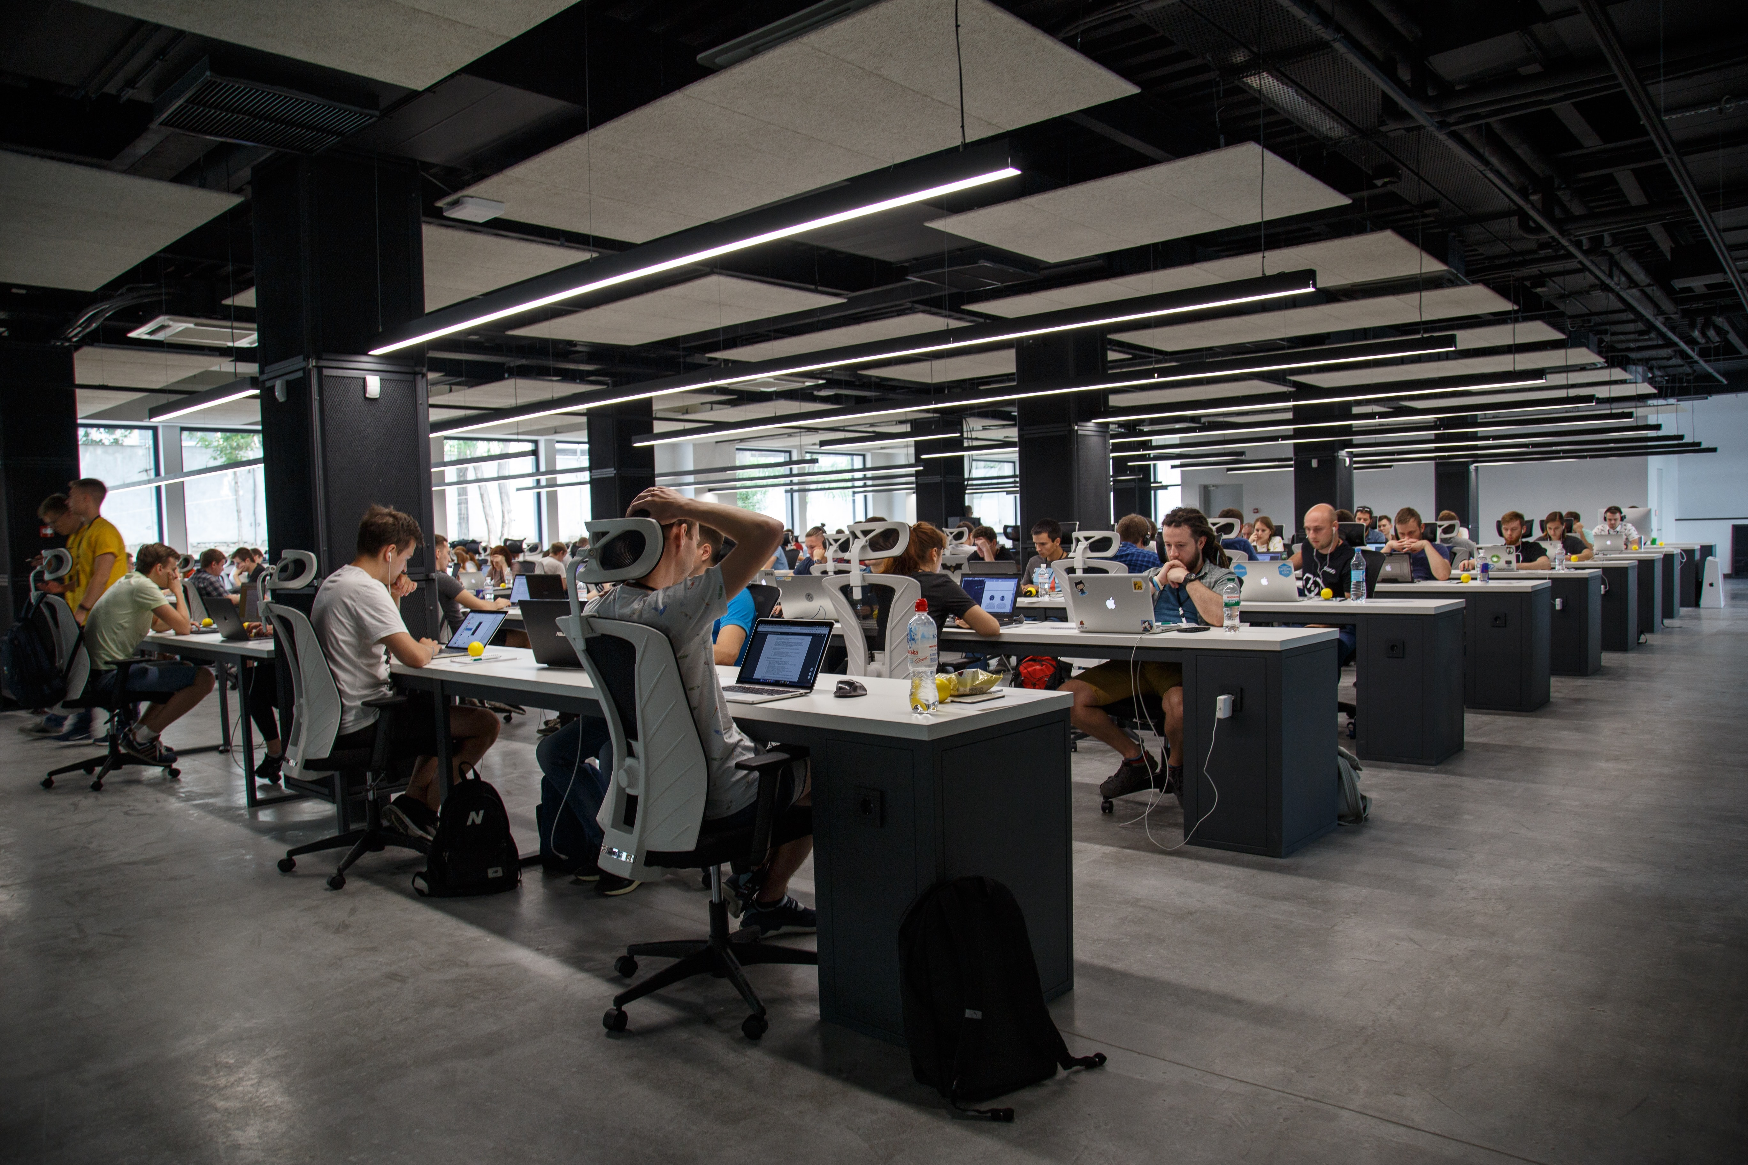
Wherever your people are…
Until now, the focus was on Health, Safety and Security (EHS&S) at the office and when people are traveling (TRM).
Photo by Alex Kotliarskyi on Unsplash
Notes:
Photo by Alex Kotliarskyi on Unsplash
--------------------

Slide 10

Wherever your people are…
Now it is continuous People Risk Management (PRM) wherever they are working or traveling.
Photo by Avi Richards on Unsplash
Notes:
Photo by Avi Richards on Unsplash
----------------------------------

Slide 11
People Risk Management (PRM)
Protecting people and keeping them productive is at the heart of operational resiliency. This includes risks TO and FROM your people.
ADAPT to “office anywhere” realities
ANTICIPATE people’s risks wherever they are located
PROMOTE workplace and mental wellness
RESPOND to added stresses

Slide 12

PRM is a change of perspective
The asset that you are helping to protect
is the Person,
not just the Trip!
Photo by Nathan Dumlao on Unsplash
Notes:
Photo by Nathan Dumlao on Unsplash
----------------------------------------------

Slide 13
You bring a lot to the table
– skills and tools

Slide 14
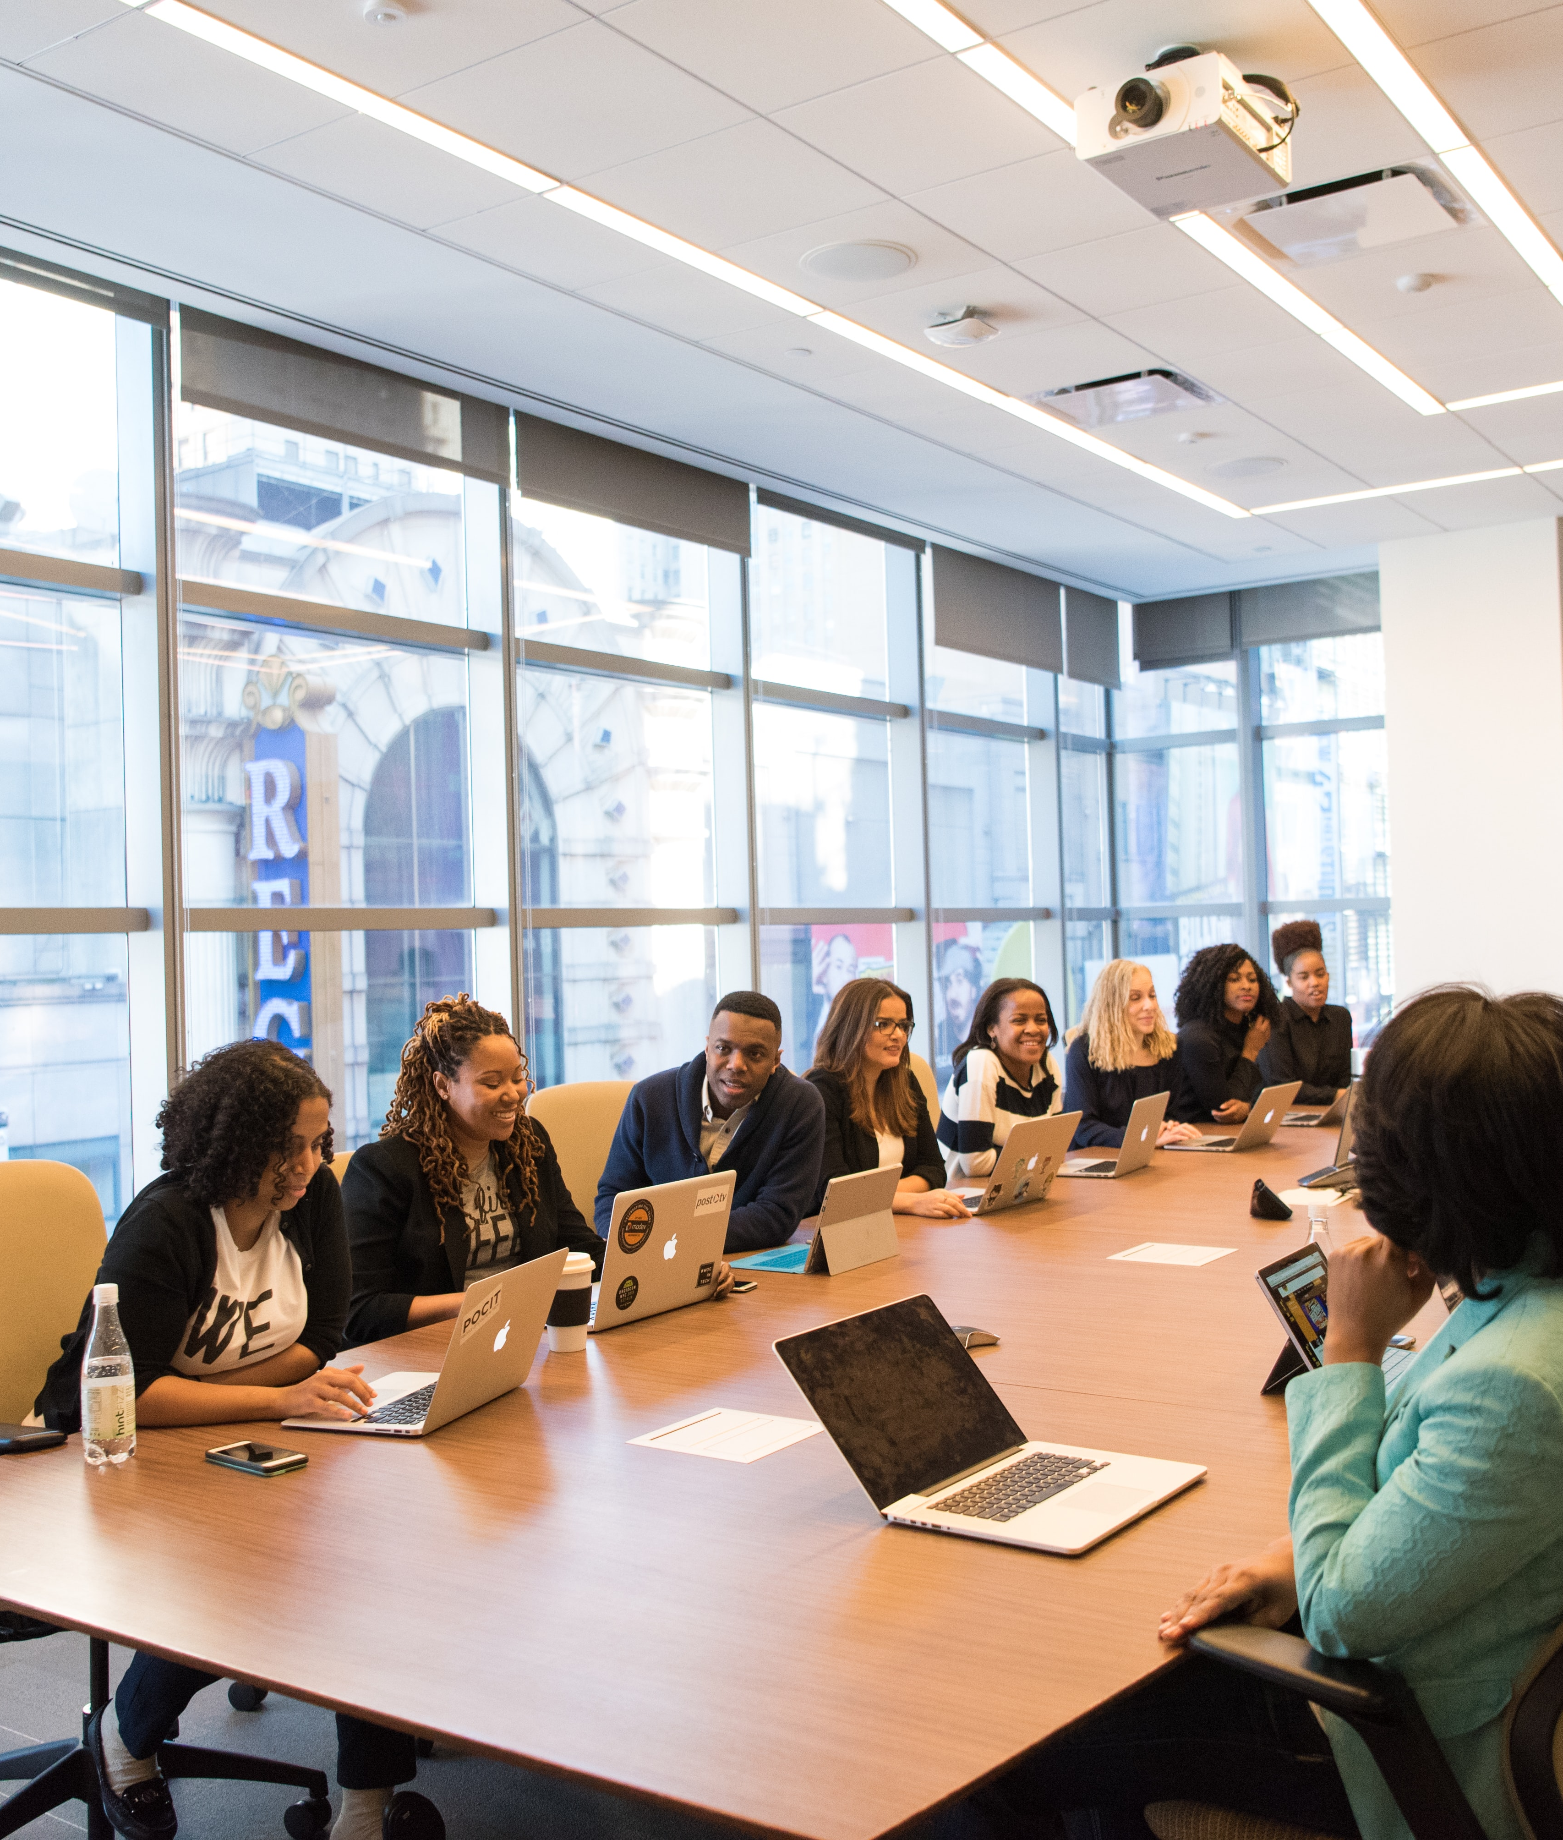
What you bring to the table…
Wellness – Physical, Mental, and Financial
Support mobility – transient and long-term
Trusted source of “People Location”
Support corporate functions and line management to do periodic reporting & check-ins
Your Data! Support Audit around compliance areas – immigration, tax, etc.
Photo by Christina @ wocintechchat.com on Unsplash
Notes:
Photo by Christina @ wocintechchat.com on Unsplash
------------------------------------------------------------

Slide 15
Leverage your seat at the table
Finance
Legal & Compliance
Security
(Physical & Cyber)
Health & Safety
Human Resources
Risk & Insurance
Mobility (Travel, Assignment, WFA)

Slide 16
How to get traction within
your organization

Slide 17
How to transform your TRM program
Partner with HR, Risk, IT, Security (physical & cyber), EHS, others
Tools – Can TRM platform/tools support people NOT on a trip?
Profiles for all your People – email, mobile, home location (can people input manually or email their itinerary?)
Reports to support insurance, immigration and tax?
Messaging – Notify locals - Tune-up your notifications to not spam people with alerts & messages
Testing - Conduct periodic notification (2-way) tests

Slide 18
Data - Applying TRM to PRM
Location Awareness and Risk Management
Profile - for every Person (start with Employees)
Default Location – Assigned location or residence
Contact Information – Need anyway for travel, messaging, alerts
Booked Trip – Evaluate risk of travel plan
Change of Location – Evaluate risk of new Location
During Trip – Dynamic update of location
WFA – Person needs to update where they are (“Sign-in for your day”)
Reporting – Compliance, Tax, etc.
Education – “Just in Time” based on movement or threat

Slide 19

Q&A
Questions, Feedback, Need Help…. Hub & LinkedIn
GBTA Risk Committee

Slide 20
Before you leave
Give us Your Feedback -
It’s in the App!
1- Click on « Schedule »
2- Find and add your session
3- Move to the bottom
4- Take the survey ☺
Join us to continue this conversation!
« Meet the experts »
Re:Imagine area in the Expo
11:15 – 11:45
Table 5

Slide 21
thank you for attending :)

