Slide 1

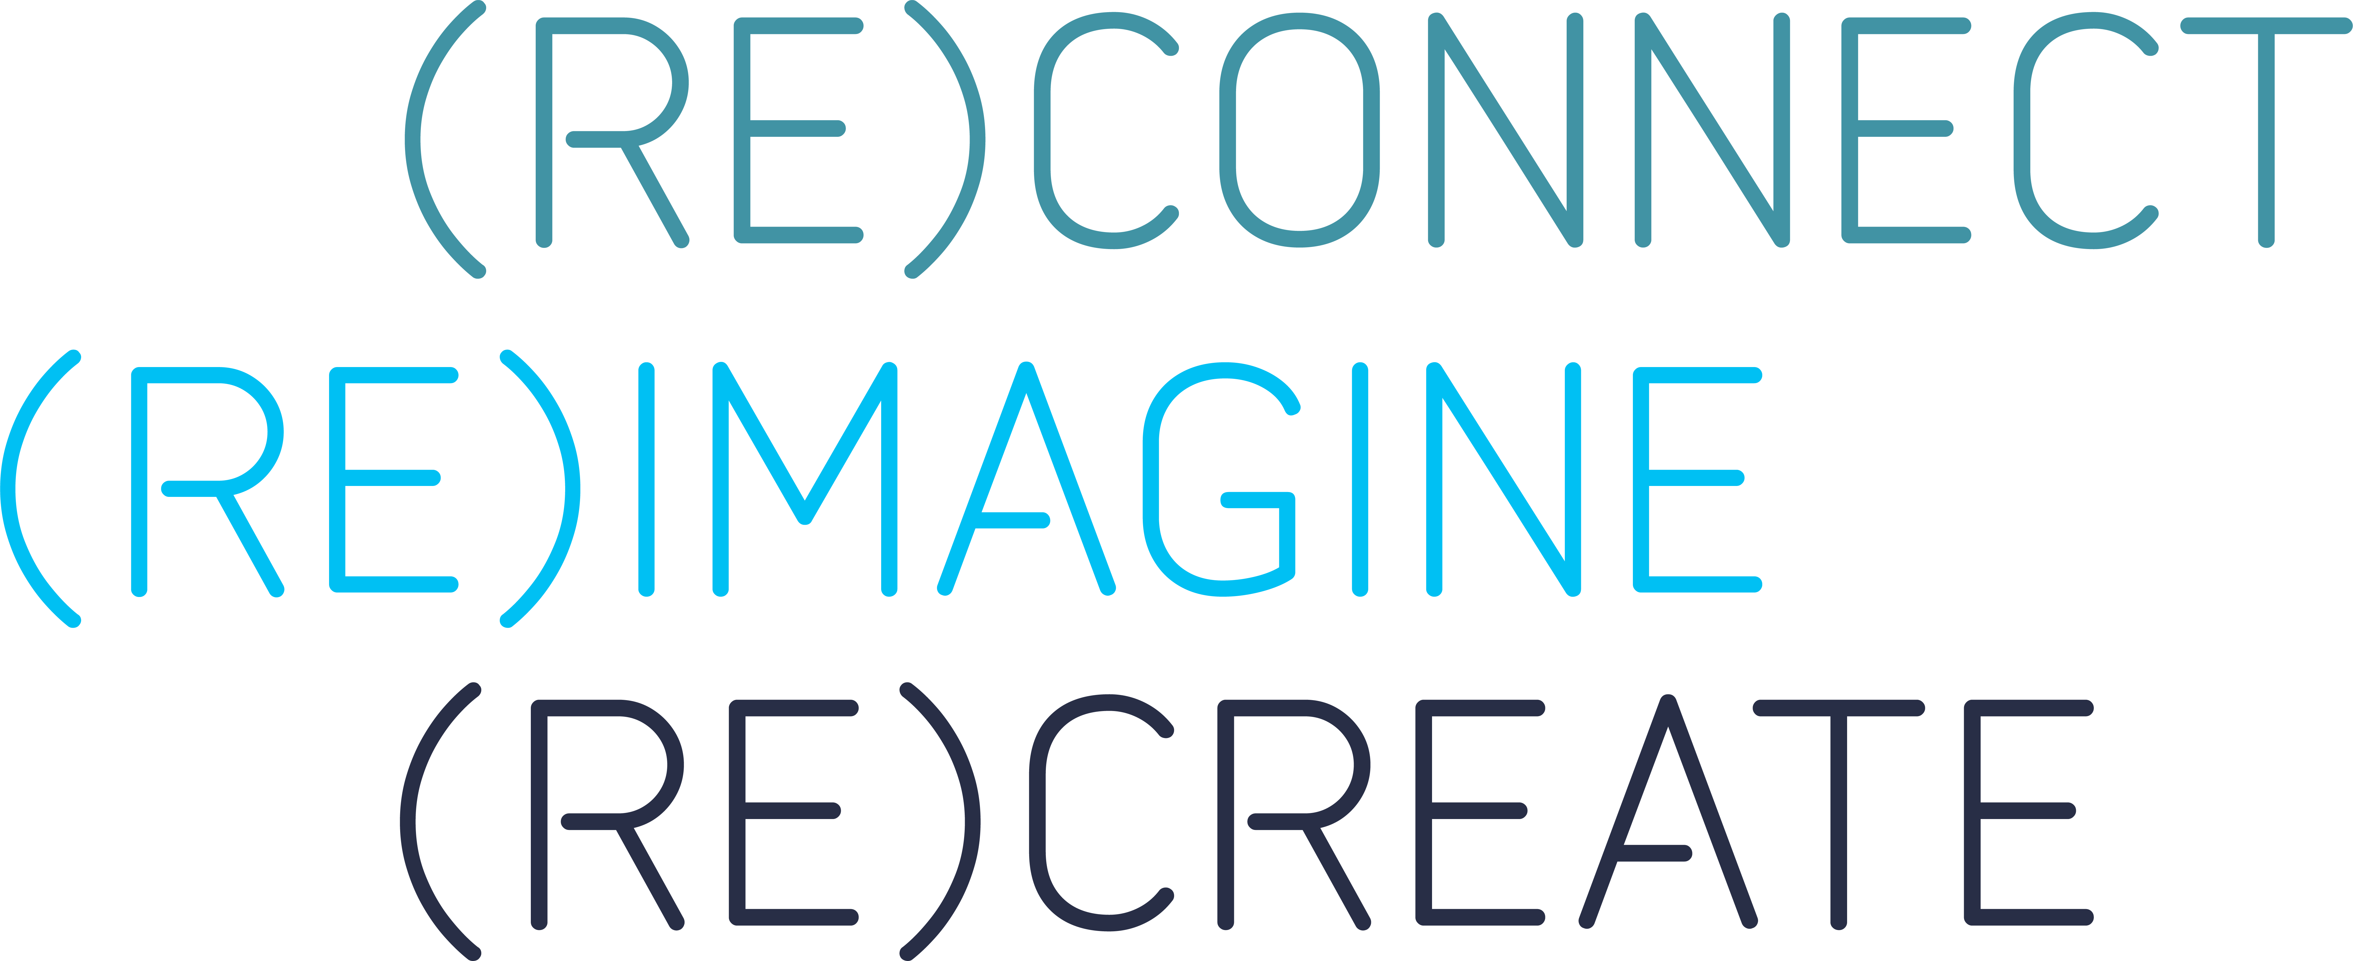
GBTA Aviation Committee – 09NOV22
NDC: 10 years after

Slide 2




Panelists
Olivier Benoit
Calum Hawley
Will Owen Hughes
Daniel Murphy
Vice President
Advito
GBTA Aviation Committee
Global Travel Manager
Endeavour Mining
GBTA Aviation Committee
Head of Strategy
Travelport
Airline Partnership & Travel Technology Leader
FCM
NDC: 10 years after

Slide 3

1. NDC in perspective
2. Panel
3. Q&A

Slide 4
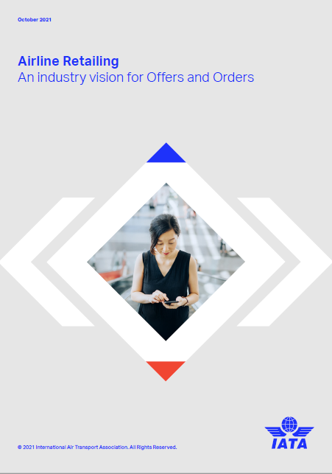
IATA: Air Retailing Vision
Enhanced Distribution
Modern retailing framework
Personalized Offers
Dynamic Offers
CUSTOMERS
Simple Fulfilment
ONE Order and Settlement with Order
NDC: 10 years after
Notes:
Financial community has welcomed the IATA initiative which tell us that the new model will drive higher profitability for airlines through cost reduction and additional revenue opportunities
Revenue opportunities:
Differentiation (product description, BtC like UX & UI)
Merchandizing (ancillaries, fare families, other services)
Personalization (based on loyalty, preferences)
Dynamic Pricing (based on supply, demand)
Cost savings:
Increased competition and innovation (GDS / TA)
Reduce the GDS & CC & BSP payment costs
Increase the share of Direct sales
Move away from paper based legacy processes to reduce the fulfilment cost

Slide 5
A very long journey…
2012
2014
2015
2019
2021
2022
Resolution 787 (NDC)
US DOT validation
First usable NDC schema v17
Resolution 797 (One Order)
First DCC, private channels
NDC@scale (level 4 certification)
Settlement with Order (SwO) framework
End of Full Content
Airline maturity index (ARM)
NDC schema V23.x
NDC: 10 years after
Notes:
New entrants
DCC / Distribution Surcharge / Commercial decision from airlines / Private Channel to immune key partners from the surcharge
End of full content

Slide 6
…with aggressive goal
100%
NDC adoption
in 2030
All segments (2022)
10%
Corporate segments (2022)
<1%
NDC: 10 years after
Notes:
Major gap between leisure and business travel due to the complexity of business travel
Requires GLOBAL / SCALABLE / CONSISTENT for
Multiple countries
Multiple airlines
Multiple TMCs
Multiple OBTs
Multiple GDSs or Direct connects
Complex itineraries
High flexibility
Additional services / duty of care…
Is it realistic ? Let’s ask our panel

Slide 7
Panel
Use cases
Tech challenge
Business model
NDC: 10 years after
Notes:
What is the current status. What are you busy with. What are the pain points. What are the expected benefits?
Calum:
Firstly, tell us more about your prog?
Globally NDC is less than 1% of business segment. How many in your program?
What are your pain points?
Eventually, do you think Air retailing model will bring benefits?
Will:
Airlines are asking TM / TB to push their TMC / Tech to act quicker.
What is wrong with “you” (tech companies) ?
Why does it take so much time?
Maturity API
Standardization effort
Downstreams processes / TMC OBT eco systems
What will be the expected benefits?
Contextualize search / Offer / Order Mgt (airline)
Travel policy compliance challenge?
Trust challenge?
Dual system / Edifact & NDC running in parallel // requires filtration and logic based on value to display relevant no duplicate options
Dan: Let’s explore the TMC perspective
Impact pandemic / Resource shortage
What are the benefits of the new model from a TMC perspective?
Do you think 2030 is a realistic timeline for 100% Adoption?
Do you have a NDC implementation success story to share?
Wrap up / take away
What do you recommend to your peers or what do you expect from your supplier?

Slide 8
Use
cases
Q&A
Tech challenge
Business model

Slide 9
Before you leave
Give us Your Feedback -
It’s in the App!
1- Click on « Schedule »
2- Find and add your session
3- Move to the bottom
4- Take the survey ☺
Join us to continue this conversation!
« Meet to the experts »
Re:Imagine area in the Expo
14:00 – 14:30
Table 19

Slide 10
thank you for attending :)

