Slide 1
Sarah Whiting, BCD Travel
Harnessing the power of the Total Trip.

Slide 2


#9646742
What word comes to mind when you are thinking about data ?
ⓘ Start presenting to display the poll results on this slide.
Notes:
Before we get going and start to discover how data can help us harness the power of the total trip, I wanted to take a temp check in the room and see what is it that you think of most when it comes to data? Don’t worry about being overly positive for my sake, I sometimes find data especially travel data to be frustrating but it can also be overwhelming in size, and of course it can be insightful and surprising … so tell me your thoughts and while you do that I’ll just give you a little bit of my background with data. I came to the UK to study data analytics because I’ve always been fascinated with the signal…. There was a brilliant book I read in my undergraduate that talked about all the noise that data creates.. Noone really saw the value until the signal was found – this is the part that makes data valuable and actionable.. So I went searching for the signal and found myself as an analyst in the travel industry where I discovered just how much data our industry creates – now, lets look at the results and see what sentiments we have towards this topic and whether we might be able to address those throughout - * read some of the word cloud results*

Slide 3

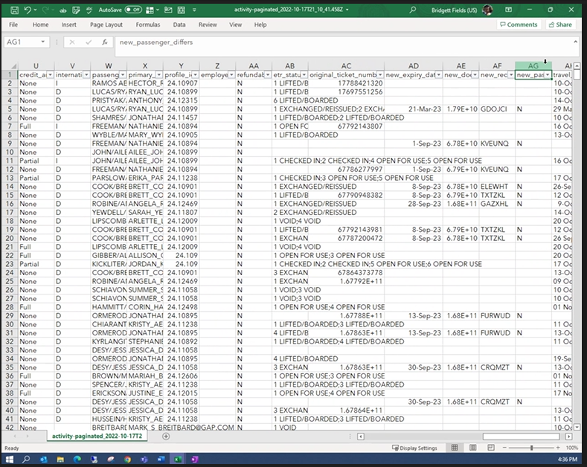
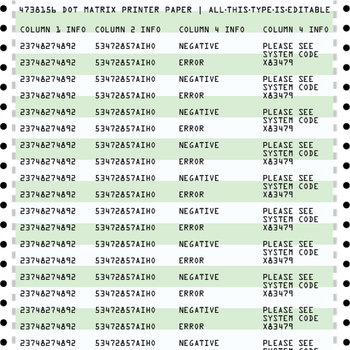
Manual data processing & analyses
Notes:
Okay so a lot of those words lead us on to what I see as a transition period we are in with data – raise of hands, who has a love/hate relationship with excel ---- what about just a hate relationship lol – I def have a love hate, because we’re in a stage where there are some of us who remember when they just got monthly excel reports with rows and rows of data and You’d analyze this data with your team and make program adjustments maybe monthly or quarterly based on findings. And to some extent this is still relevant because I know if you’re looking for a specific insight in the data it is easier to just get a download of it all and pivot down until you find the signal you’re looking for. But going forwards, this is becoming increasingly impractical, you might not get to the reports for a few days and miss an opportunity to flag a high-risk destination for travelers. Or flag a pattern of costly booking errors. The list of reasons for needing an innovative approach to data goes on and on – so what does that innovation look like…

Slide 4
WHAT IF….
Notes:
Okay so, given access to real-time data-
What if you had a 360-degree view of your traveler’s trip, like a live, start to finish, door to door, play by play including every detail of what the traveller has experienced… from there what patterns would you spot in the journey, what pain points could be removed? How much could you learn about the behaviors you want to encourage in the wider travel population? How could you take that information and create tailored recommendations for the traveller’s next journey? The possibilities here are endless to optimize the traveller’s experience
On the flip side,
What if, your data scope went beyond the traveler and you had again real time insights into service data patterns, how many contacts did a traveller make with the agency and what are the respective changes to that booking? What is the most effective communication channel to match satisfaction levels and If they are calling to perform an administrative task, can there be service efficiencies achieved by using automation?
This is where we are heading when it comes to data innovation and like I said we’re in a transition between that and the manual processes we’re all familiar with… but how do we get there?

Slide 5



More, better, smarter data
Data consolidation
Data Quality
Actionable Insights
Notes:
The type and amount of data you have access to has changed, if you think about that total trip journey – as someone who works for a TMC, we’re well placed to be the consolidator of that information but the sheer volume of information generated across multiple suppliers for one trip is insane… and so we have to as an industry get better at consolidating data consistently – so from the taxi that took that traveler to the airport to the tram they took from the airport to the city centre when they got there and even to what they spent in the hotel on food and beverage, we as a TMC won’t have immediate visibility and unless we all work together to consolidate that information, there is no way to harness the insights we could gain from having that 360 view.
Then we have the data quality, which includes harmonization, not just across the global points of sale which all have varying levels of quality, also across other internal departments, we as an industry have evolved beyond travel, and creating quality reporting for financial or operational departments to leverage has become a standard requirement
And sometimes quality is subtle and hard to conceptualize, but thinking about what inisghts they need to provide - one piece of data in a trip record is then leveraged to tell us a lot of important things, as an example an origin and destination data point has to tell me, the duration of the trip in hours which is put against a calculation for days at destination (tax reporting), mileage between the two, which goes through all of the carbon emissions calculations and the list goes on and on. So when we say quality, yes we mean all the boxes are filled and correct, but we also mean the data is normalized and massaged for us to elevate it to the next level of insight capability.
So we talked big picture about the value of the total trip view but the practical and proactive insights that we can provide from the total trip break down roughly into 3 categories and these form again the reasons we are pushing forward with data innovation in travel

Slide 6

Catch and correct
Catch and protect
Catch and inform
Notes:
What if you could…. And I’m going to briefly lay these out for you and then have a think about how much your current access to data allows you to perform these actions with real time data.
Catch and correct – correct in real-time travelers who continue to book air on a route with viable rail options to support your sustainability goals.
Catch and protect – protect travelers – real time insights on when travelers are affected by security or health threats – not waiting to be contacted by 3rd parties but knowing at the time of the event that travelers are safe and allow the 3rd parties security providers play their part?
Catch and inform – real time insights – we see a booking has come in with transit through the Philippines, did you know you still require a yellow fever vaccine certificate despite the short transit time?
Thinking of these examples, and whether your data unlocks them…. Now think, are these currently automated actions for you or are they still manual?

Slide 7

#9646742
With which of the following catches have you felt you most struggled with or could improve in your programme?
ⓘ Start presenting to display the poll results on this slide.

Slide 8
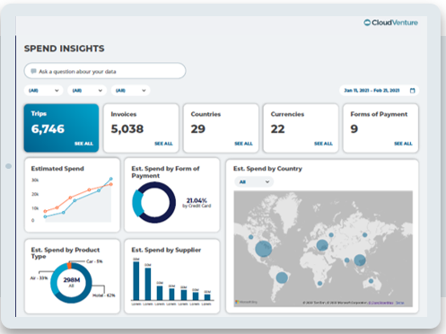
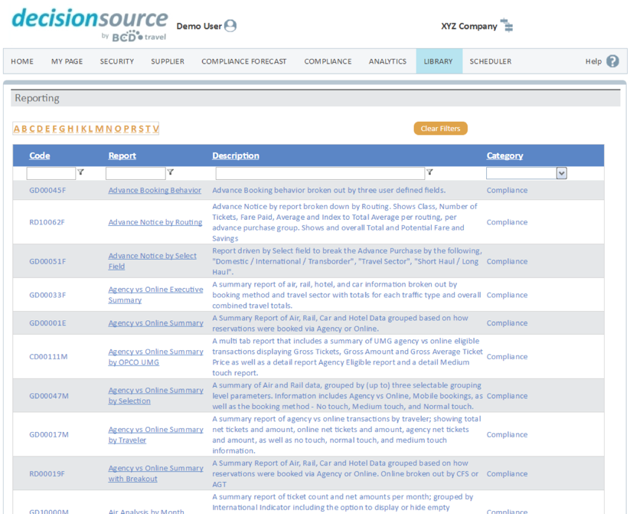
On-Demand Insights
Notes:
So we have established we have a TON of data. Sounds daunting, right? Not necessarily. As we just discussed, technology has allowed us to package that data in the form of curated, often custom insights that tell you what you need to know proactively.
On-demand is the practice of pulling data when you need it from a system or tool. You can view data in the form of a summary level dashboard or very specific detailed reports.
There are even query tools specific to your program: Example “show me the travelers that are not flying DELTA between Newark and London” “show me hotel stays in New York over the 300,00 threshold” (Custom criteria in time to make changes -or create new processes)

Slide 9
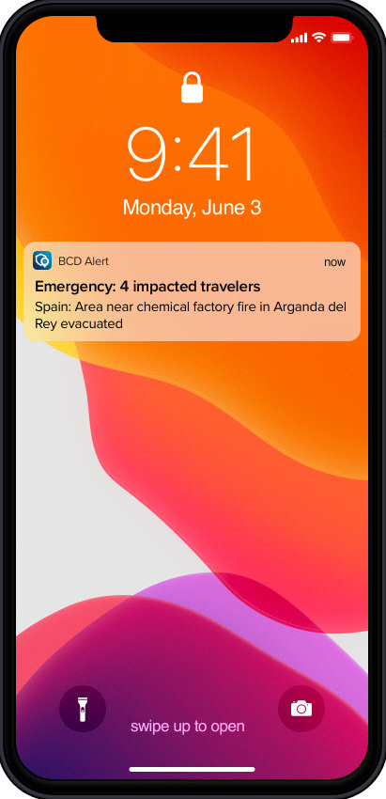
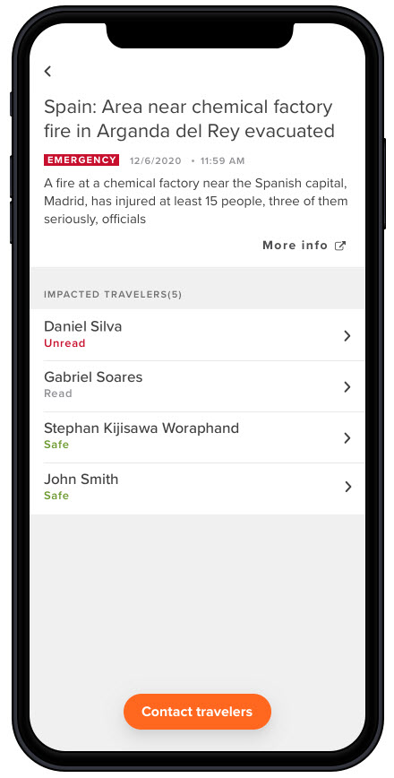
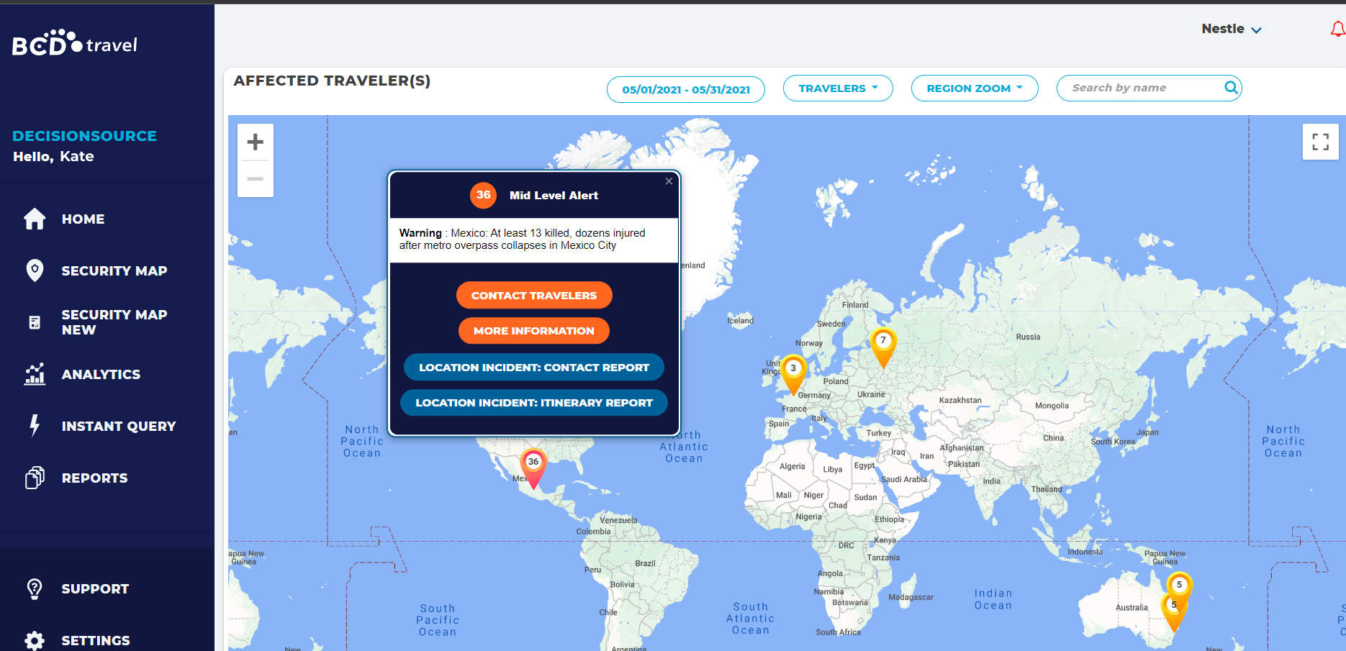
Push Alerts (the shoulder tap)
Traveler risk and response
Data thresholds
Contract expiration
Notes:
Push data is information that is triggered based on a schedule or event. Examples of event-based information include security events, specific data thresholds - like if you’ve reached the employee threshold for a single flight- or a contract expiration. These notifications can be pushed to any device and usually trigger an action. Like contacting employees in an emergency. We call this the shoulder tap because it’s like a virtual assistant letting you know that action is required. And who doesn’t need one of those?

Slide 10





Open access data
Analytics
Platforms
Itinerary Data
Third Party Partners
Payment Charges
Data Lake
CSV/Excel
Invoice
Data
Mobile
Profile Data
APIs
Notes:
Maybe you have your own systems and tools and want to connect directly with a curated, structured set of data that you can filter and display based on your company’s needs. Or maybe your traveler security provider wants to access real time itinerary data from the TMC. You can make that happen. A single record of data across systems improves accuracy, support and provides clean data on the back end.

Slide 11


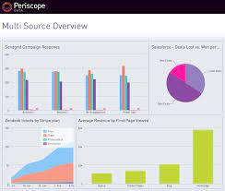



Catch, correct, protect and inform
Travel
Manager
Traveler
CorrectProtect
Inform
Catch
Notes:
What do you do with the information once you have it? Again, You correct, protect and inform travelers by reaching them where they are. Of course, we’re automatically updating travelers of impact to their itinerary or journey but some of those communications are trigged by the data catch examples we just discussed. Communicating with travelers using these data insights can turn into a massive task depending on your communication tools, but with the ability to push these insights and “tap them on the shoulder” with an automatic heads up – then you’ve got a proactive catch and communicate strategy that operates without too much interference with yourself.
Your TMC should be able to help here. Rules-based messaging engines, mobile app notifications, email, itinerary messages….all triggered by data.

Slide 12

The balance between OpEx against CX
Notes:
As a travel manager, doing what is right for your company and doing what will make your travelers happiest are not always mutually exclusive. This paradox can make decisions difficult. Imagine having the ability to understand the relationship between the travel policy, the service experience, and traveler satisfaction.
We have many ways to measure operational performance like hold times, call times and service experience. But do we fully understand that affect’s traveler sentiment? What if, given a 20 second longer waiting time, travelers are reporting the same levels of satisfaction or even higher levels? What if we could tell you exactly how many touch points there were in a transaction and identify opportunities for automation? On policy, what if there was one small tweak that could make a big impact on traveler engagement and satisfaction? Something that give back time or encourages wellness. With the right data we can measure, make changes, measure and make changes again, until we reach that perfect balance of operational efficiency and traveler satisfaction.

Slide 13
Some parting advice…
Be prepared to pay for quality data
1
Know when to call in the experts
2
3
Think outside the program
Notes:
Expect to pay. The collector of the data invests heavily in technology to consolidate, cleanse, secure and curate data. Most companies include a baseline of program data and insights as a standard. But you will likely pay for some of the more advanced enterprise consolidation services or data feeds and APIs. It’s a worthwhile investment.
Know when to call in the experts. Corporate travel is complicated. And keeping up with traveler demands, new technologies and ways to cut costs can be intimidating, There are firms that specialize it the digitization and optimization of travel programs. Everything from policy and travel engagement to supplier negotiations and sustainability. Use them. Most TMCs have a consulting arm for this reason.
Think outside the program. Find time each week to look across the industry. It’s important to look up from the day to day to see what’s coming next or to see what’s working for other companies. There is so much good (free) research out there on industry trends, new technologies and evolving practices. Look to GBTA, Skift, Phocuswright… BCD has their own research and innovation team and publishes reports, case studies and more on an ongoing basis and anyone can access and I’m sure some of the other TMC’s do as well.

Slide 14
Before you leave
Give us Your Feedback -
It’s in the App!
1- Click on « Schedule »
2- Find and add your session
3- Move to the bottom
4- Take the survey ☺
Join us to continue this conversation!
« Talk to the experts »
Re:Imagine area in the Expo
Table 1

Slide 15
thank you for attending :)

