Slide 1
Jo Lloyd, Global Head of Consulting & Account Management, FCM
What Should Tomorrow’s TMC Model Look Like?

Slide 2
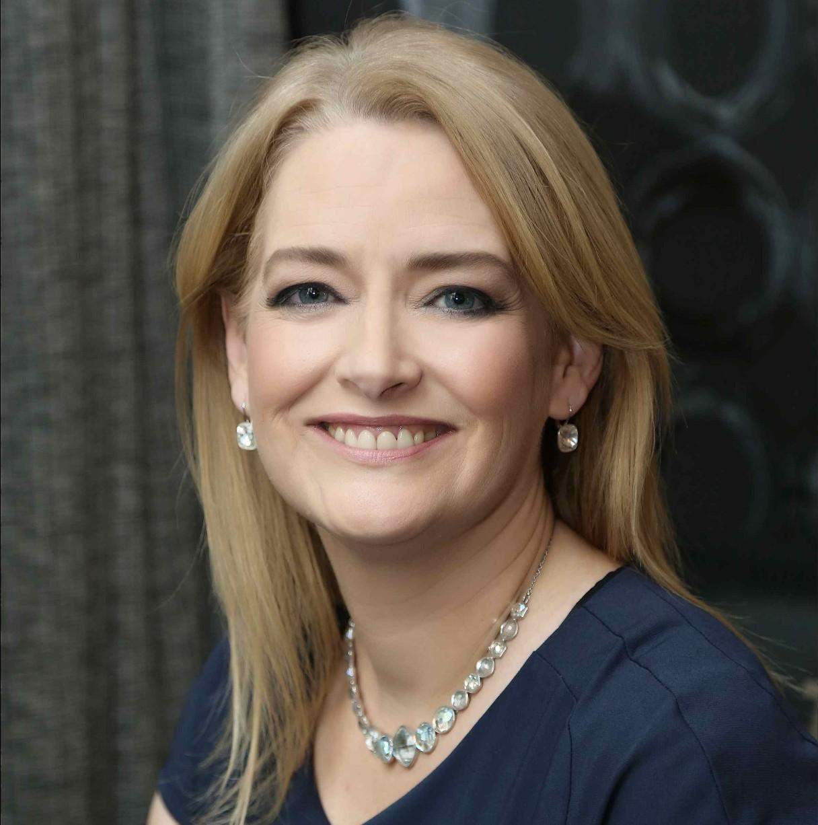
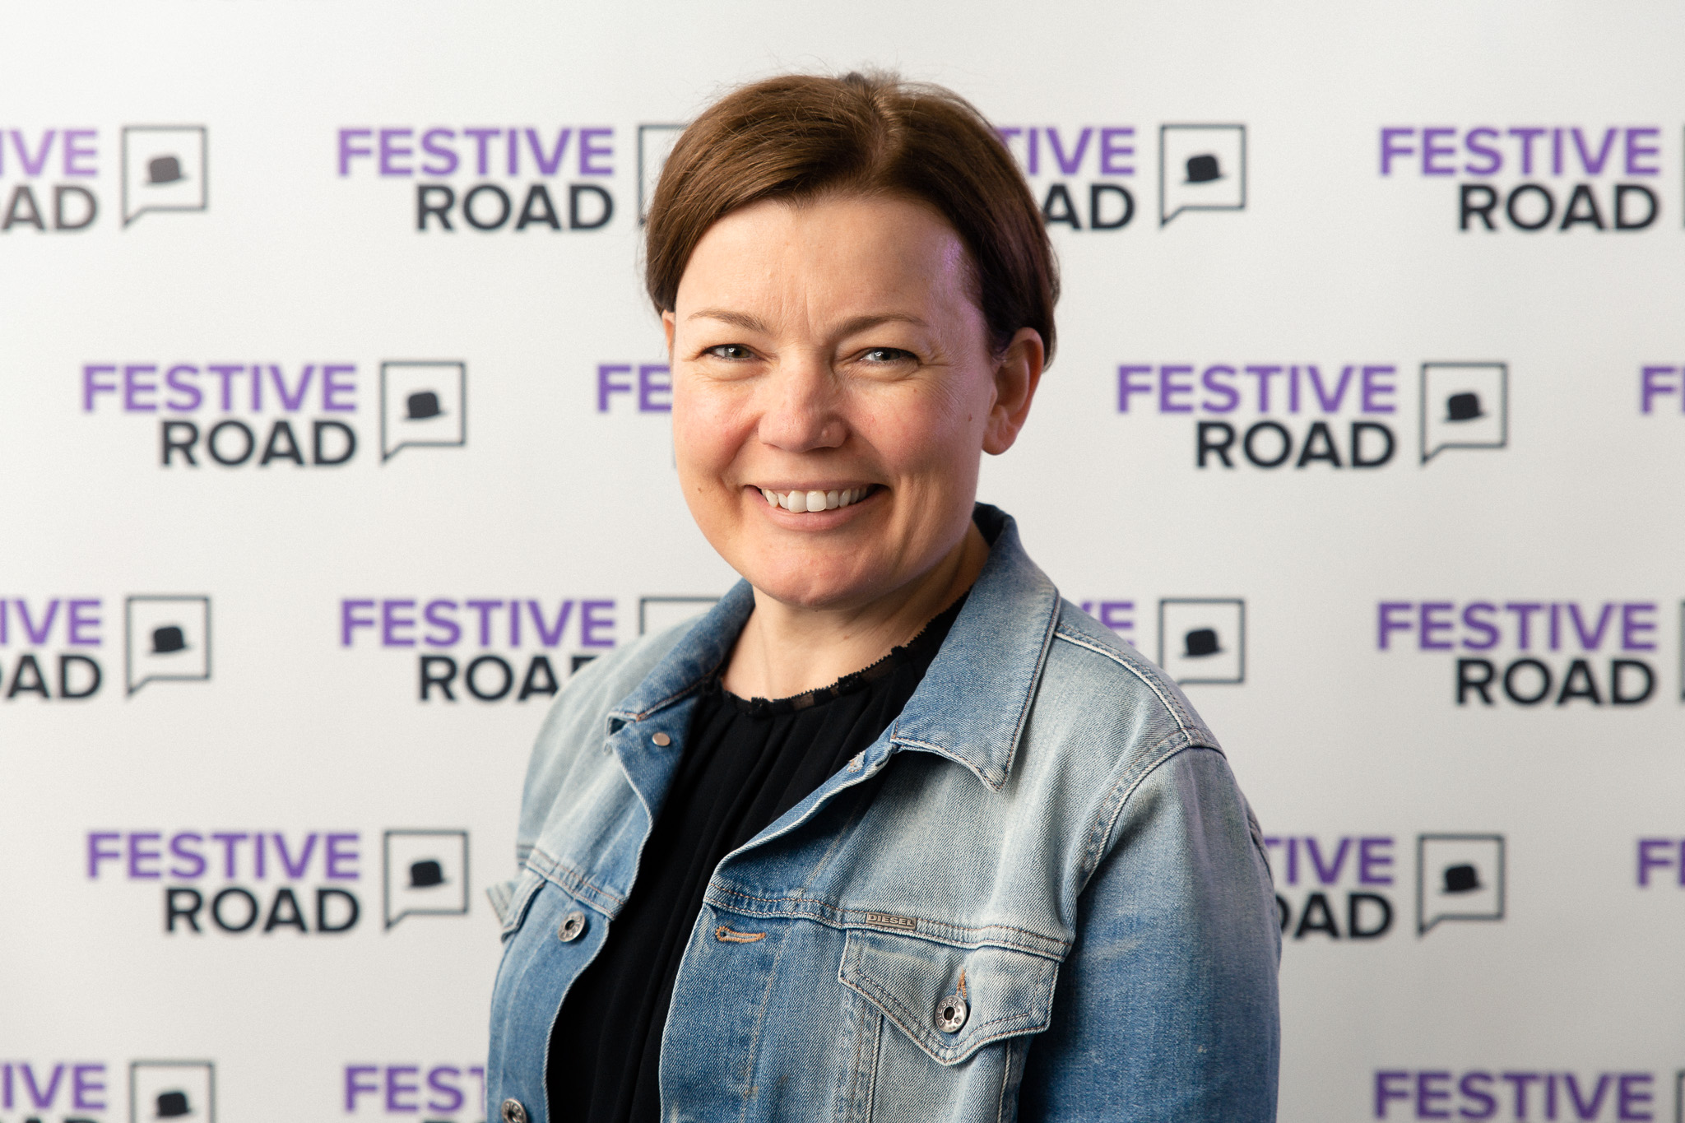
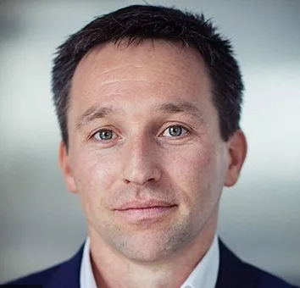
Meet the Speakers
Ben Park
Senior Director Procurement & Travel
Parexel
Jo Lloyd
Global Head of Account Management and Consulting, FCM
Caroline Strachan
Managing Partner,
Festive Road

Slide 3
Before you leave
Give us Your Feedback -
It’s in the App!
1- Click on « Schedule »
2- Find and add your session
3- Move to the bottom
4- Take the survey ☺
Join us to continue this conversation!
« Meet the experts »
Re:Imagine area in the Expo
14:00 - 14:30
Table 13

Slide 4
thank you for attending :)

