Slide 1


Hansini Sharma, Practice Lead – Corporate Travel, Acquis Consulting Group
Let’s Get Digital!
Giving Your Travelers the Experience They Deserve.

Slide 2
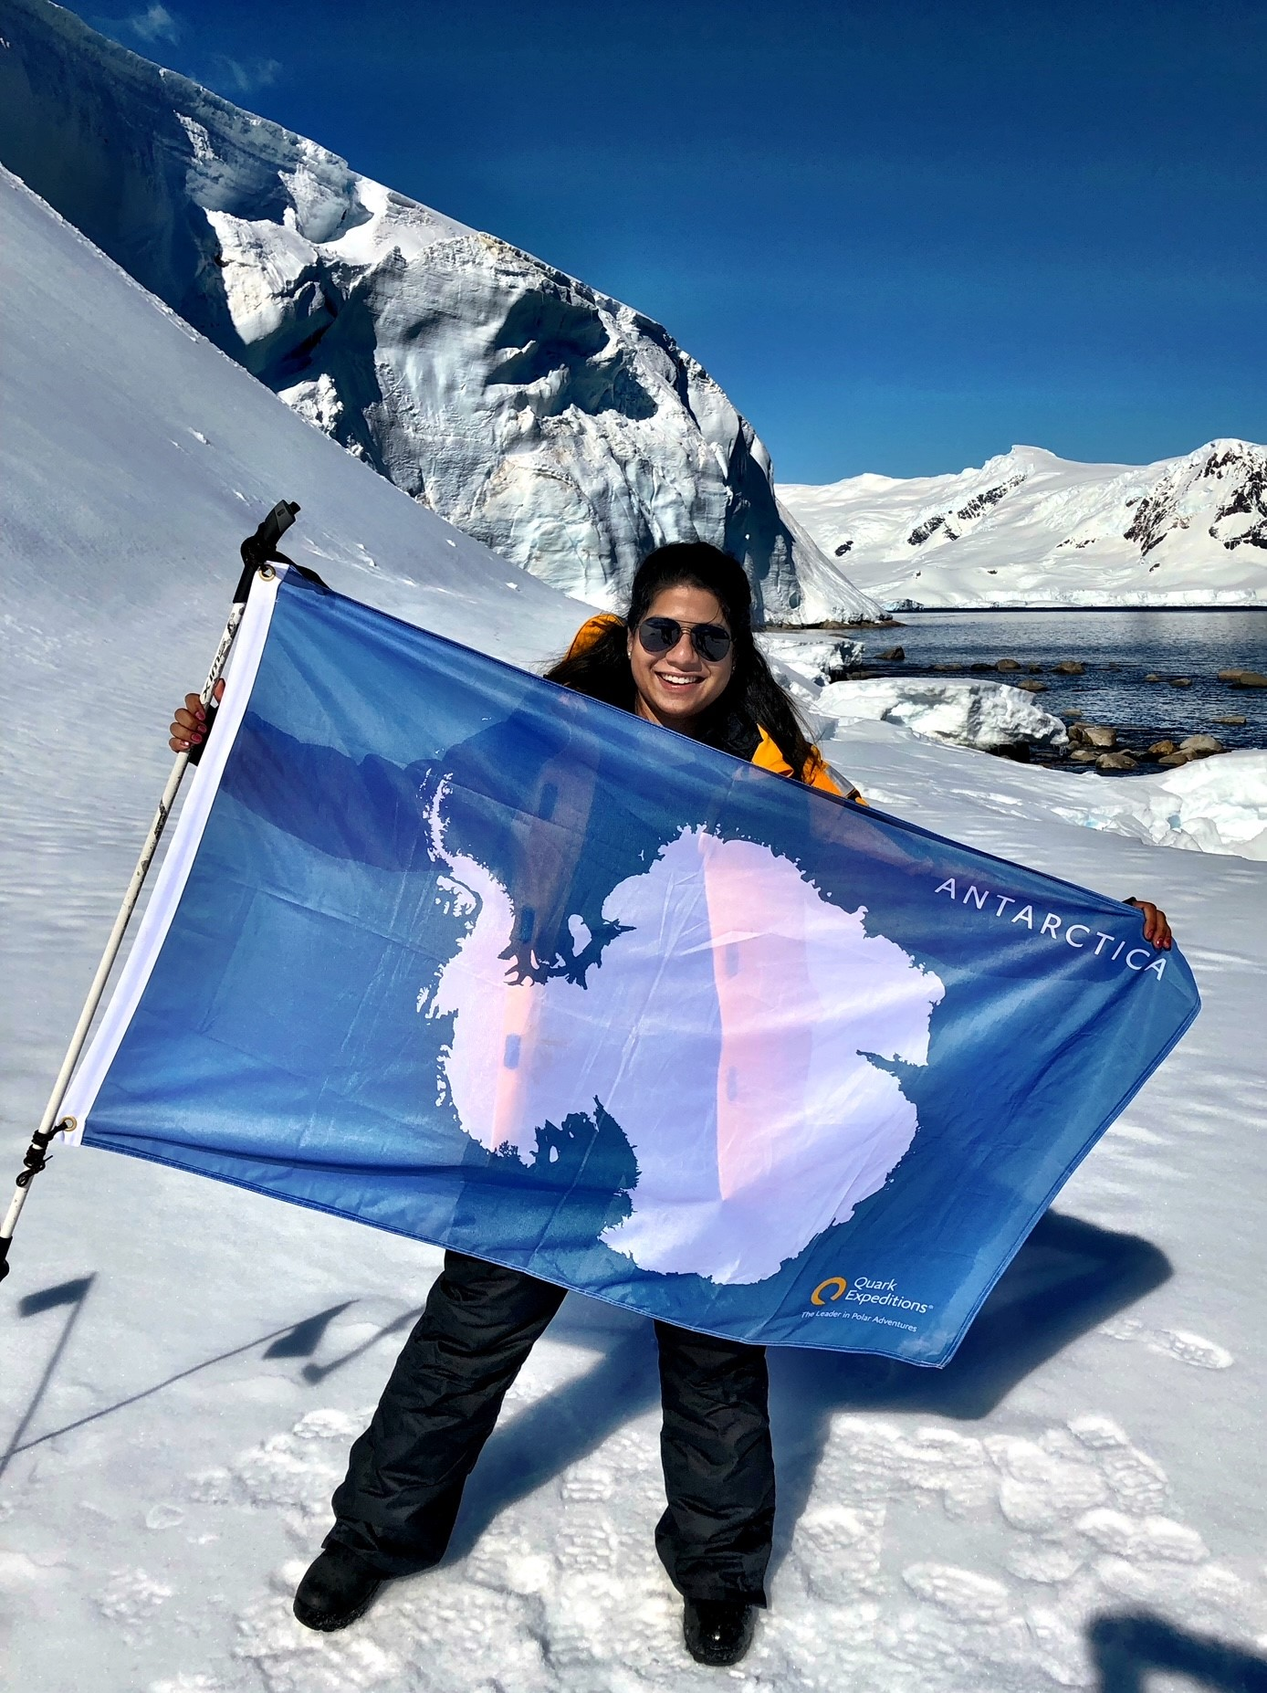
Hi, I’m Hansini!
Location: New York, New York
Years in Travel: 15
Favorite Travel Destination: Buenos Aires & Paris
Longest Business Trip: 22 Days

Slide 3
I want to fly in a higher class of service.
What’s the dress code for this meeting?
Do I need to travel for this meeting? Can I just dial in?
What if someone on my team can’t make it in-person for our meeting?
Can I expense lounge access?
Do I need to speak to people when I arrive at the hotel?

Slide 4

The
Customer Journey
has changed.

Slide 5
What is a Customer Journey?
Understand the motivations, pain points, and intentions of the travelers.
A customer journey is the key to gaining a deeper understanding of your customer, which in this case is the traveler.
Define traveler needs, interactions, and problems that can be overwhelming, but also have potential solutions and remediations.
Enable data driven decision making for your program, beyond the technology solutions and looking at emotions and motivating factors.

Slide 6
Why does the Customer Journey matter?
Data, Data, Data
Efficiency
Logic
Collect quantitative and qualitative metrics
Use findings to create simpler processes
Leverage insights gained to logically transform your program
Strategic Categorization
Organizational Integration
Identify personas that align to travel and business preferences
Merge travel into the broader organization with data driven insights

Slide 7
Traveler Journeys of the Past
Pre-Trip
On-Trip
Post-Trip
Pre-Trip Approval
Visas
Travel Booking via OBT
Receipt Collection
Hotel/Air/Car Check-In & Check-Out
Support for IROP
Expense Reports
Follow Ups on Meetings
Catching Up on Work

Slide 8
Traveler Journeys of the Present
Booking Process
Use of Free Time
Expense Reports
Trip Preparation
Work Follow Up
Meals
Packing
Hotel
Pre-Trip Work Preparation
Meeting Space
Transportation
Personal Follow Up
Airport Experience

Slide 9
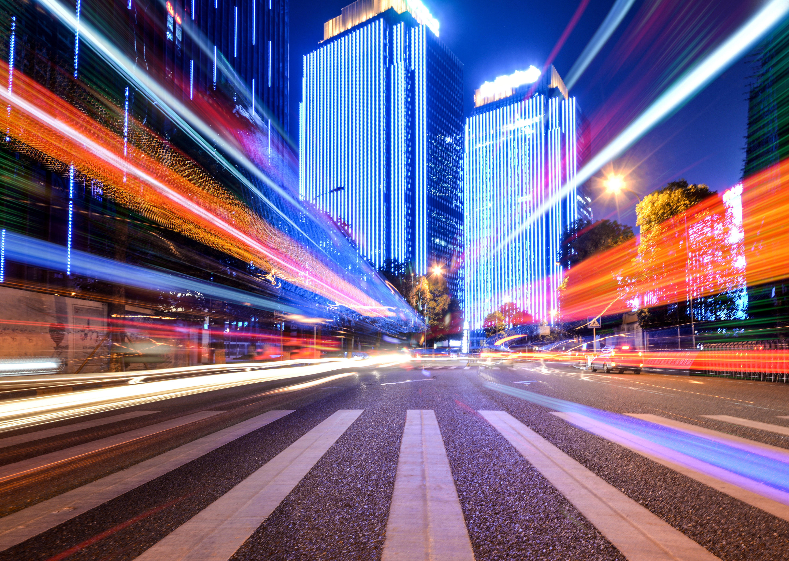
Group Activity:
Traveler Journeys of the Future

Slide 10
So what?

Slide 11
Before you leave
Give us Your Feedback -
It’s in the App!
1- Click on « Schedule »
2- Find and add your session
3- Move to the bottom
4- Take the survey ☺
Join us to continue this conversation!
« Meet the experts »
Re:Imagine area in the Expo
14:00 – 14:30
Table 17

Slide 12
thank you for attending :)

