Slide 1

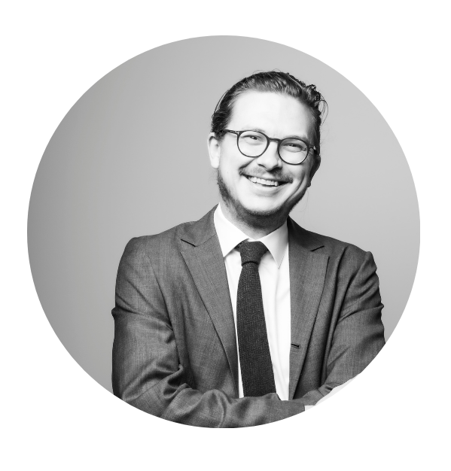
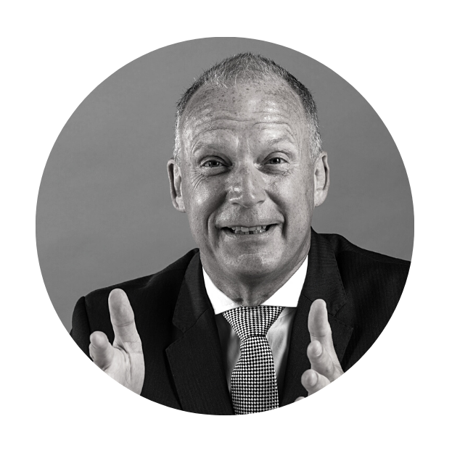
Global Secure Accreditation and Peters & Peters
The Impact of ISO 31030 on Travel Risk Management

Slide 2

Bob Quick, Executive Director, Global Secure Accreditation
What Is ISO 31030 and Why Does it Matter?

Slide 3
What Is the International Organisation for Standardisation (ISO)?
ISO is an independent, non-governmental organisation
  Standard bodies in 166 countries
  More than 50,000 experts
  800+ technical committees
  Over 28,000 International Standards
  UN Economic and Social Council
  Supporting Global Industry and Commerce
Two types of ISO Standards:
  Type A: a specification standard, can be assessed with certification provided
  Type B: a guidance standard, can be assessed or audited, but not certified
ISO 31030 likely to graduate to Type A Standard in due course

Slide 4
Why Is ISO 31030 Important?
ISO 31030 is the new standard for travel risk management:
  Organisations balance business objectives and opportunities with the necessary steps to manage risks and threats.
  Risk treatment should be proportionate to the level of risk seen or expected.
  Organisations should consider the level of risk they are prepared to accept to meet business objectives, while putting in place appropriate measures to manage risk effectively and efficiently.
  There can be occasions where the level of risk is unacceptable, and travel should not take place.
  An organisation’s travel risk criteria should be recorded in the TRM policy.

Slide 5
Benefits of ISO 31030
Corporate management assurance
Increased safety and security / reduced risk
Reduced risk
of litigation
Staff and Staff Association assurance
Increased confidence & productivity
Continual improvement

Slide 6
Andrew Wallis, Of Counsel,
Peters & Peters
Legal Risk in Light of ISO 31030

Slide 7
ISO Guidance: Why Follow?
Not regulation or law.
Range of factors may influence decision whether and how to follow guidance. To be balanced against competing demands of resources and company risk profile.
However, BSI/ISO standards have historically been found influential by the courts in England and Wales.
Notes:
What can travel managers do to meet best practice?
What are the benefits and operational improvements of meeting the guidelines?
In travel things can go wrong etc., handover to Andrew

Slide 8
Governors of Hospital for Sick Children v McLaughlin & Harvey Plc 1987 10 ConLR 25
“British Standards Codes of Practice are not legal documents binding upon engineers or upon anyone else, but they reflect the knowledge and expertise of the profession at the date when they were issued. They are guides to the engineer and, in my view, they also provide strong evidence as to the standard of the competent engineer at the date when they were issued.”
HHJ Newey QC, p93

Slide 9
Ward v Ritz Hotel (London) Ltd [1992] Lexis Citation 3704
“Mr McDonnell submits that the judge gave too little weight to the British Standard, and I agree with him. As he says, they represent the consensus of professional opinion and practical experience as to the sensible safety precautions. How much weight they attach to them is shown by the words which I have quoted used in the laying down of the Standard.”
McCowan LJ
Notes:
What can travel managers do to meet best practice?
What are the benefits and operational improvements of meeting the guidelines?
In travel things can go wrong etc., handover to Andrew

Slide 10
Green v Building Scene Limited and Another [1994] PIQR P259
“Looking at a photograph of the stairs, I would myself form the view that they are reasonably safe... But it is a fact that the stairs did not comply with the Building Regulations, or the relevant British Standard. That is evidence which we must certainly take into account. It represents the current professional opinion as to what is desirable in order that accidents should be avoided. But it is one thing to lay down regulations and standards, with that objective, and another to define what is reasonably safe in all the circumstances of a particular case.”
Staughton LJ, p269

Slide 11
Wray (A Minor) v Derry City and Strabane DC [2020] NIQB 39
“The court is satisfied that the risk which arose in this case derived from the activity of the Plaintiff and not by reason of anything which the Defendant had done or omitted to do. The purpose of the fence, self-evidently, was to keep persons out of the Centre during hours when the Centre was closed and its configuration was such as to deter those who might be interested in climbing over it. The court is of the view that the Plaintiff was aware of these matters. Like Deeny J, as he then was, in Phillips, this court will take account of the fact that the fence was perfectly legal and conformed with British Standards. A sign which warned against persons climbing it was unnecessary. The risk, in short, was not one which required other measures for the protection of the Plaintiff.”
Maguire J, §61
Notes:
What can travel managers do to meet best practice?
What are the benefits and operational improvements of meeting the guidelines?
In travel things can go wrong etc., handover to Andrew

Slide 12
2 Entertain Video Ltd v Sony DADC Europe Ltd [2021] 1 All ER 527
“British Standards Codes of Practice are not legally binding or conclusive in respect of issues of reasonable skill and care but they reflect the consensus of professional expertise and opinion as to acceptable standards and practice for their stated application. As such they provide strong evidence as to the standard of the competent professional at their date of issue: Ward v The Ritz Hotel [1992] PIQR 315 per McCowan LJ at p.327.”
O’Farrell J, §59

Slide 13
UK Position: Civil and Criminal Law
Civil case law regarding duty of care and risk assessments in corporate travel:
  Dusek v Stormharbour Securities LLP [2015] EWHC 37 (QB)
  Cassley v GMP Securities Europe LLP [2015] EWHC 722 (QB)
Criminal risk:
  Health and safety law
    The Health and Safety at Work Act 1974
    Corporate Manslaughter and Corporate Homicide Act 2007
  Public inquiries
Notes:
What can travel managers do to meet best practice?
What are the benefits and operational improvements of meeting the guidelines?
In travel things can go wrong etc., handover to Andrew

Slide 14
US and French Position
Papers by Morvillo Abramowitz Grand Iason & Anello PC in the US and Dartevelle Dubest Bellanca & Associés in France.
Common themes:
  Compliance with the ISO standard could have a variety of potential evidential implications in civil and criminal proceedings.
  In the US: “A court is more likely to find that an employer fulfilled its duty of care if the employer puts into place procedures and strategies to mitigate all reasonably foreseeable risks that an employee might encounter while travelling”.
  In France: “ISO 31030 appears to be a new tool for the employers to demonstrate their exoneration from liability in the event of damage suffered by one of their employees while travelling on business, to the extent that the provisions of this standard are more precise than the legal regulatory requirements of the French Labour code...”.

Slide 15
The Complexity of International Legal Risk
Difficulty of risk mapping
Complex jurisdictional legal analysis
Cost pressures within supply chain
Problematic nature of overseas investigations
Buy-in from employees
Unstable world
Notes:
What can travel managers do to meet best practice?
What are the benefits and operational improvements of meeting the guidelines?
In travel things can go wrong etc., handover to Andrew

Slide 16
Proportionate Risk-Based Steps
Internal risk assessments and mapping as a starting point.
If serious risks are identified, consider legal risk analysis.
Executive training on health & safety risk.
Read the white paper available via the conference app.
Conference for legal and compliance teams and executives in London, 15 November 2022.

Slide 17
Lee Whiteing, Director,
Global Secure Accreditation
Advice from an (Ex)-Travel Manager

Slide 18
Advice from an (Ex)-Travel Manager
ISO 31030 credibility and reach
A concern but also an opportunity
Practical steps
  Get a copy of the standard
  Review your policy against the standard
  Get a clear understanding of existing gaps
  Put in place a plan to close these gaps with realistic time frames
  Promote revised policy
  Create a feedback loop
Notes:
What can travel managers do to meet best practice?
What are the benefits and operational improvements of meeting the guidelines?
In travel things can go wrong etc., handover to Andrew

Slide 19
Any questions?

Slide 20
Contact
Bob Quick
bob.quick@gsaccreditation.com
+44 7595 606041
Andrew Wallis
awallis@petersandpeters.com
+44 7929 024 672
Lee Whiteing
lee.whiteing@gsaccreditation.com
+44 7469 896211

Slide 21
Before you leave
Give us Your Feedback -
It’s in the App!
1- Click on « Schedule »
2- Find and add your session
3- Move to the bottom
4- Take the survey ☺
Join us to continue this conversation!
« Meet the experts »
Re:Imagine area in the Expo
14:00 – 14:30
Table 5

Slide 22
thank you for attending :)

