Slide 1


Aurelie Krau,Head of Customer Success, hubli
‘Collaboration Travel’,
a passing trend or here to stay?

Slide 2
Panelists
Inge Kuijpers
Associate Director | Global Program Design – Meetings MSD
Ben Park,
Senior Director Procurement & Travel - PAREXEL
Christopher Grieves
Account Director, Corporate - Marriott International

Slide 3
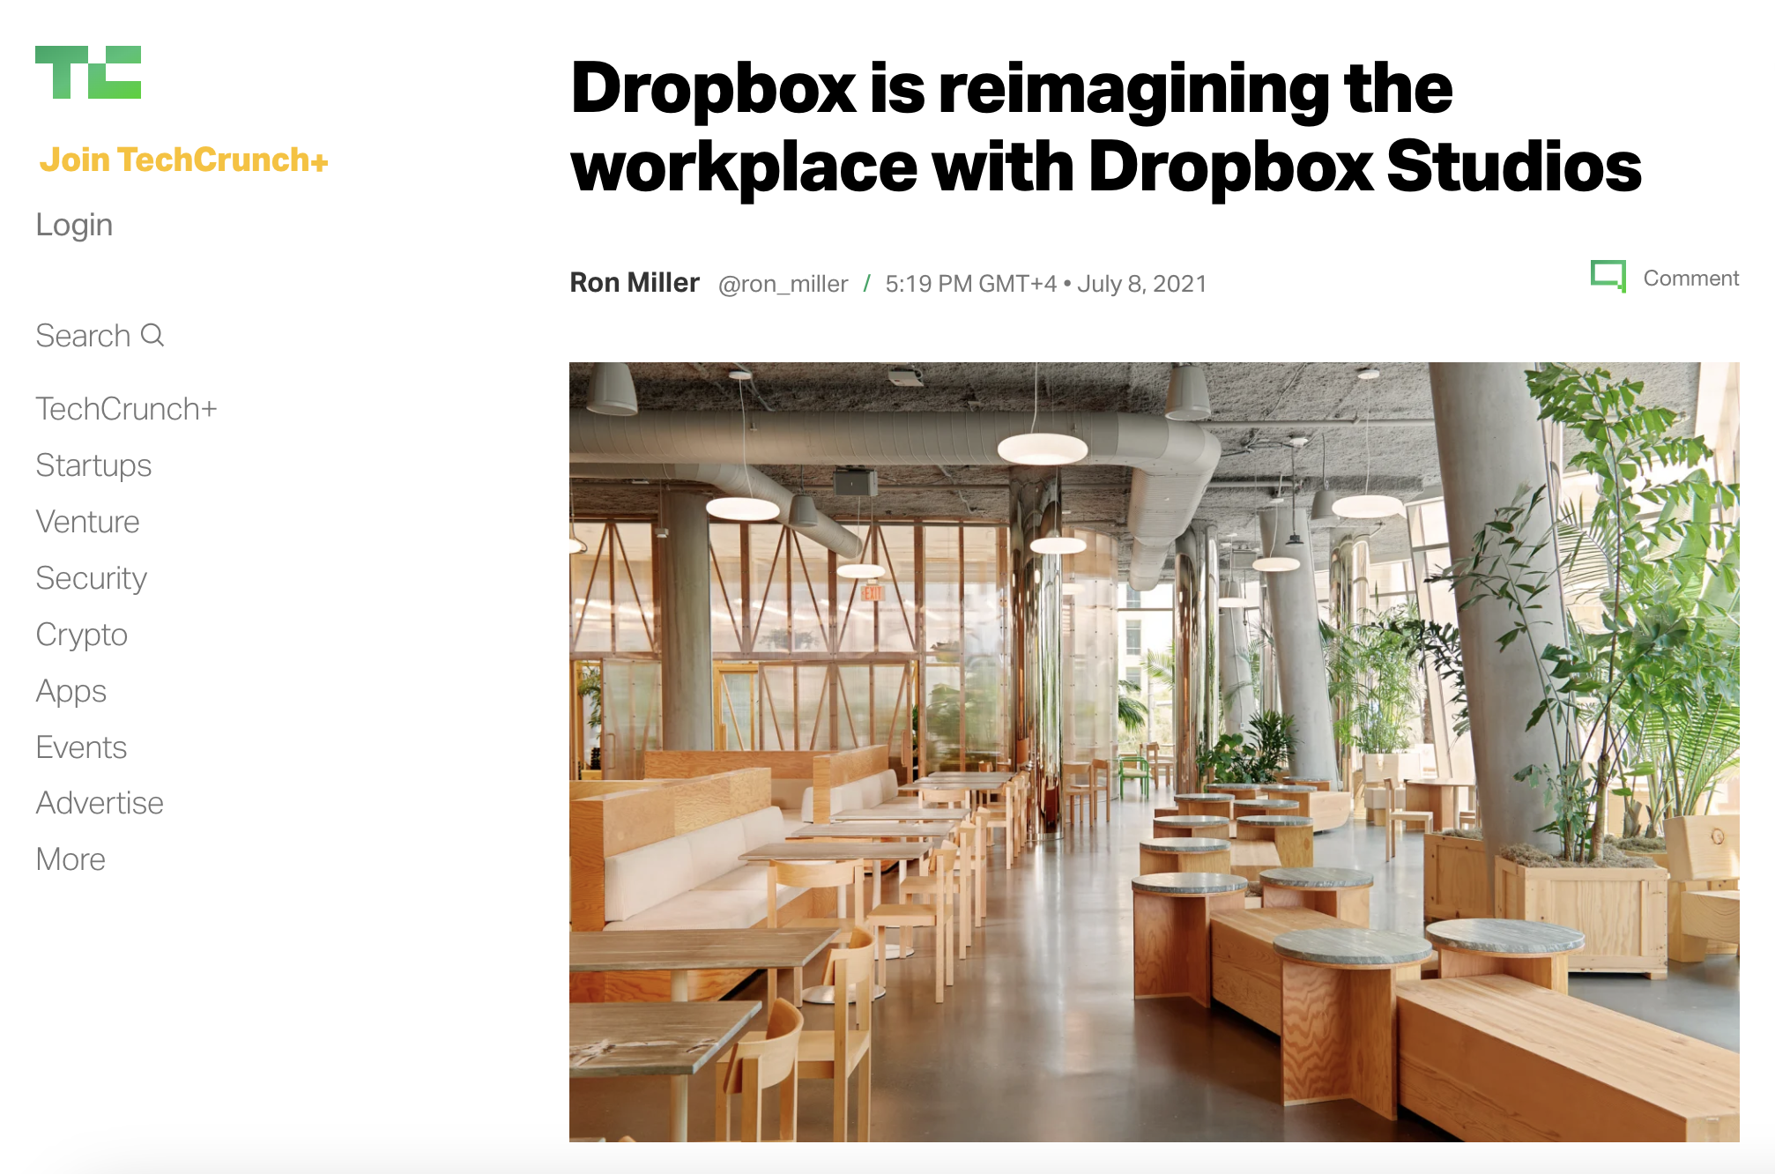
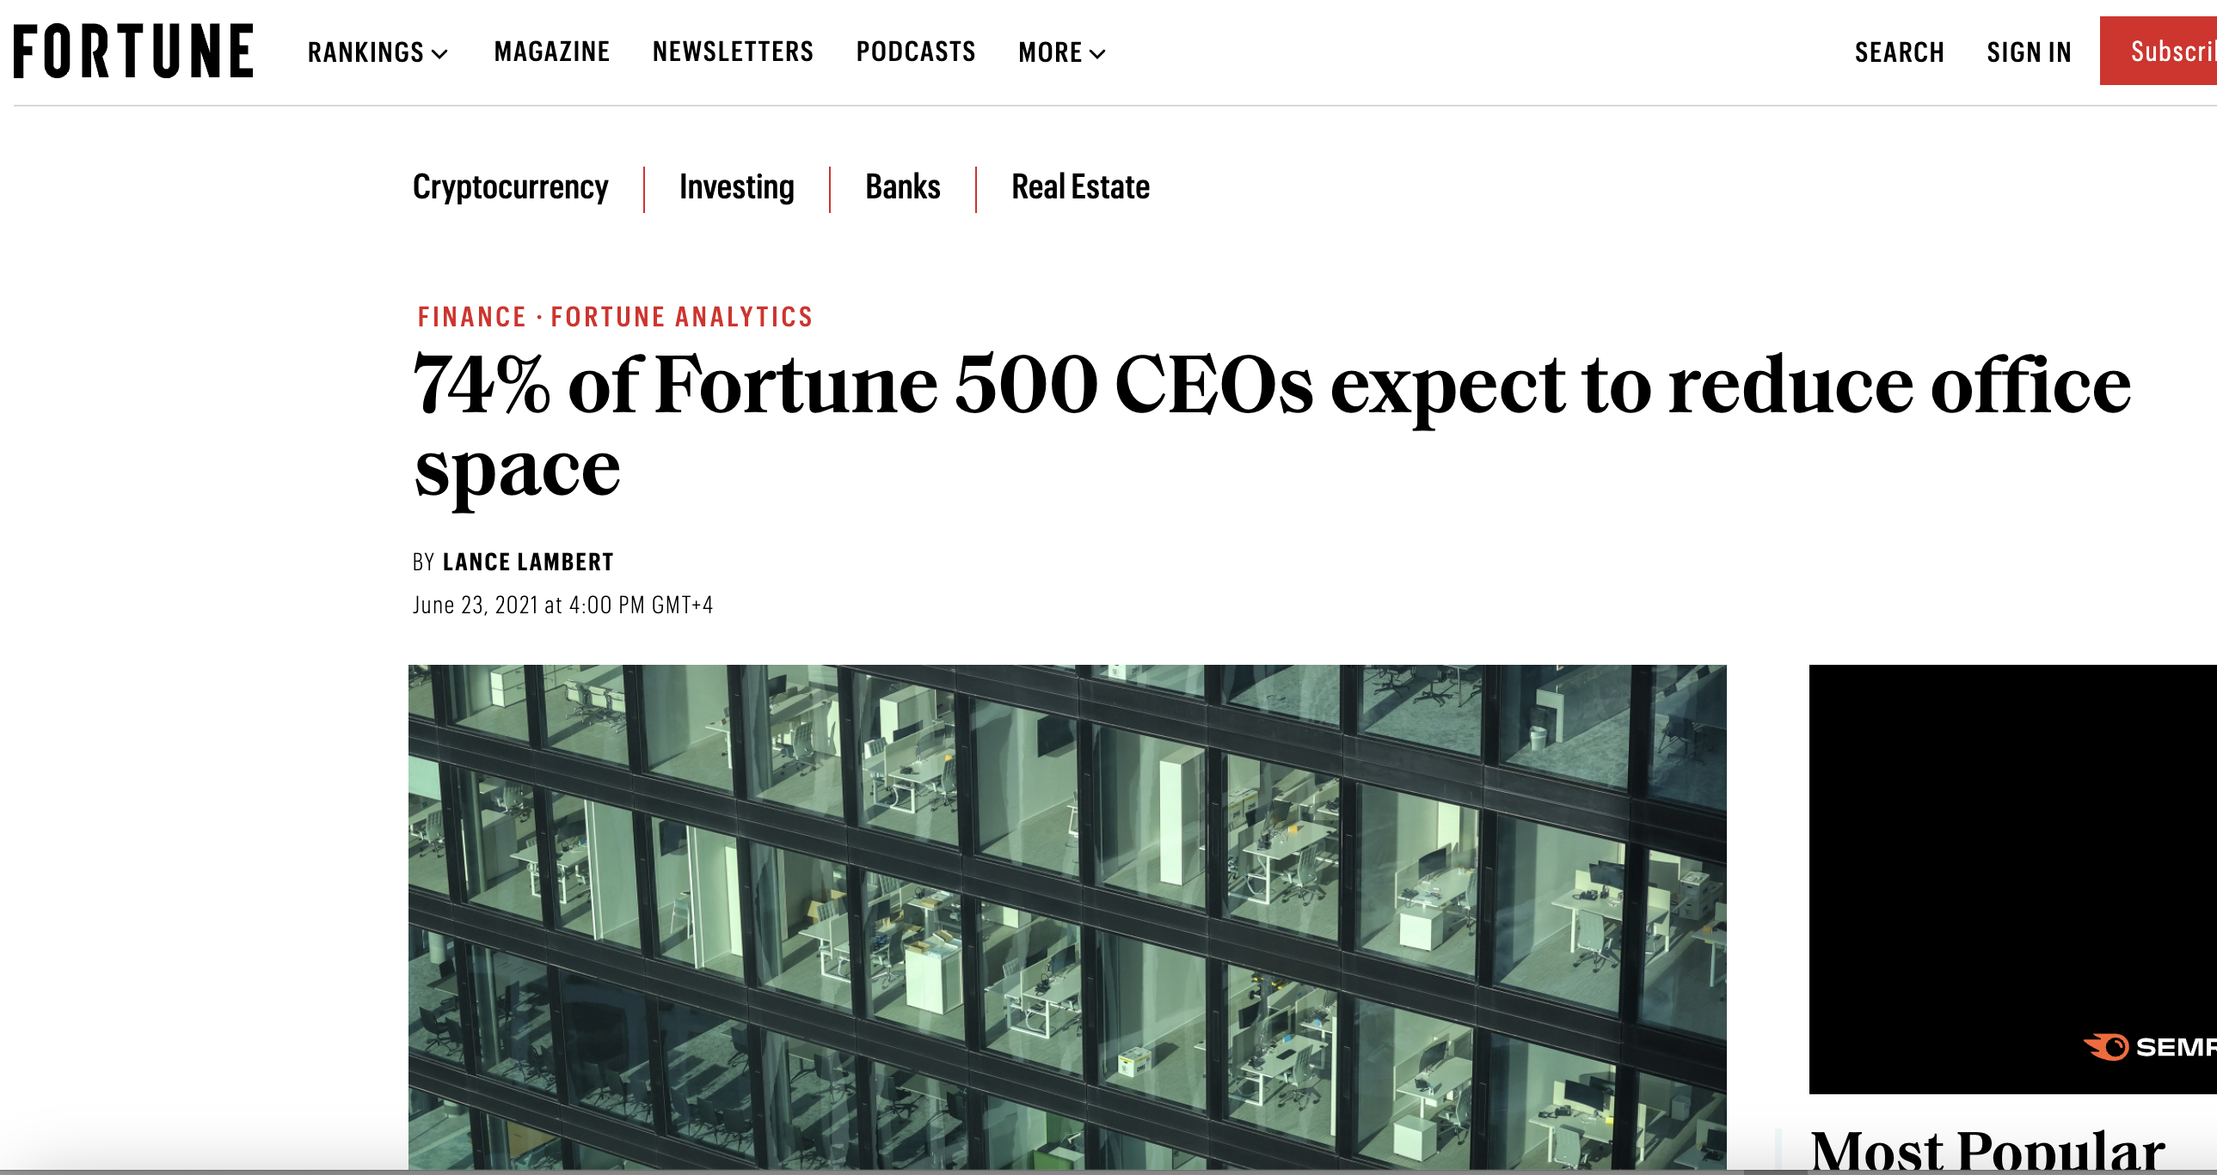
The way we work is changing
Notes:
Sources:
https://techcrunch.com/2021/07/08/dropbox-is-reimagining-the-workplace-with-dropbox-studios/
https://fortune.com/2021/06/23/companies-reducing-office-space-fortune-500-ceos/

Slide 4
Collaboration Travel: Key Trends
1. Smaller meetings
Average attendee size 24 versus 36 pre-pandemic
(-39% decrease)
2. Team offsites
(2+ day residential meetings)
+17% increase in booking volume
3. Travel back to office / hubs
(group stay only bookings)
+200% increase YTD vs 2019
source: hubli booking data

Slide 5
1. PULSE
In 1 word, tell us what it feels like to manage travel/meetings in this new era?
Join at
Slido.com
#2765 584

Slide 6


In 1 word, tell us what it feels like to manage travel/meetings in this new era?
ⓘ Start presenting to display the poll results on this slide.

Slide 7
2. STRATEGY
Overall, a shift in average meetings cost is to be expected. By how much?
0-5 %
5-10 %
10+ %
No shift expected
Join at
Slido.com
#2765 584

Slide 8

Overall, a shift in average meetings cost is to be expected. By how much?
ⓘ Start presenting to display the poll results on this slide.

Slide 9
3. STRATEGY
The reasons why we travel and meet require a new approach.
How are you managing this?
Our company has a decision matrix
Our company is currently working on it
Our company has not seen the need for that (yet)
I’d rather not say
Join at
Slido.com
#2765 584

Slide 10
The reasons why we travel and meet require a new approach. How are you managing this?
ⓘ Start presenting to display the poll results on this slide.

Slide 11
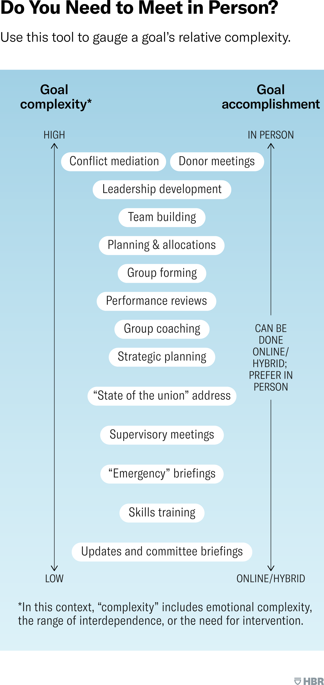
3. STRATEGY
Do You Need to Meet in Person?
Source: HBR
Notes:
Source: https://hbr.org/2021/07/when-do-we-actually-need-to-meet-in-person

Slide 12
4. SOURCING
What products/services do we need to accommodate new behaviours?
Join at
Slido.com
#2765 584

Slide 13

What products/services do we need to accommodate new behaviours?
ⓘ Start presenting to display the poll results on this slide.

Slide 14
5. TECHNOLOGY
What are (new) technology needs for meetings / groups bookings?
Join at
Slido.com
#2765 584

Slide 15
What are (new) technology needs for meetings / groups bookings?
ⓘ Start presenting to display the poll results on this slide.

Slide 16
Stock photography sites
Stocksy - https://www.stocksy.com/
Unsplash - (free but not a very good search function)
https://unsplash.com/
Istock - https://www.istockphoto.com/

Slide 17
Before you leave
Give us Your Feedback -
It’s in the App!
1- Click on « Schedule »
2- Find and add your session
3- Move to the bottom
4- Take the survey ☺
Join us to continue this conversation!
« Meet the experts »
Re:Imagine area in the Expo
14:00 – 14:30
Table 3

Slide 18
thank you for attending :)

